Slide 1
Optiver Realized Volatility prediction

Slide 2
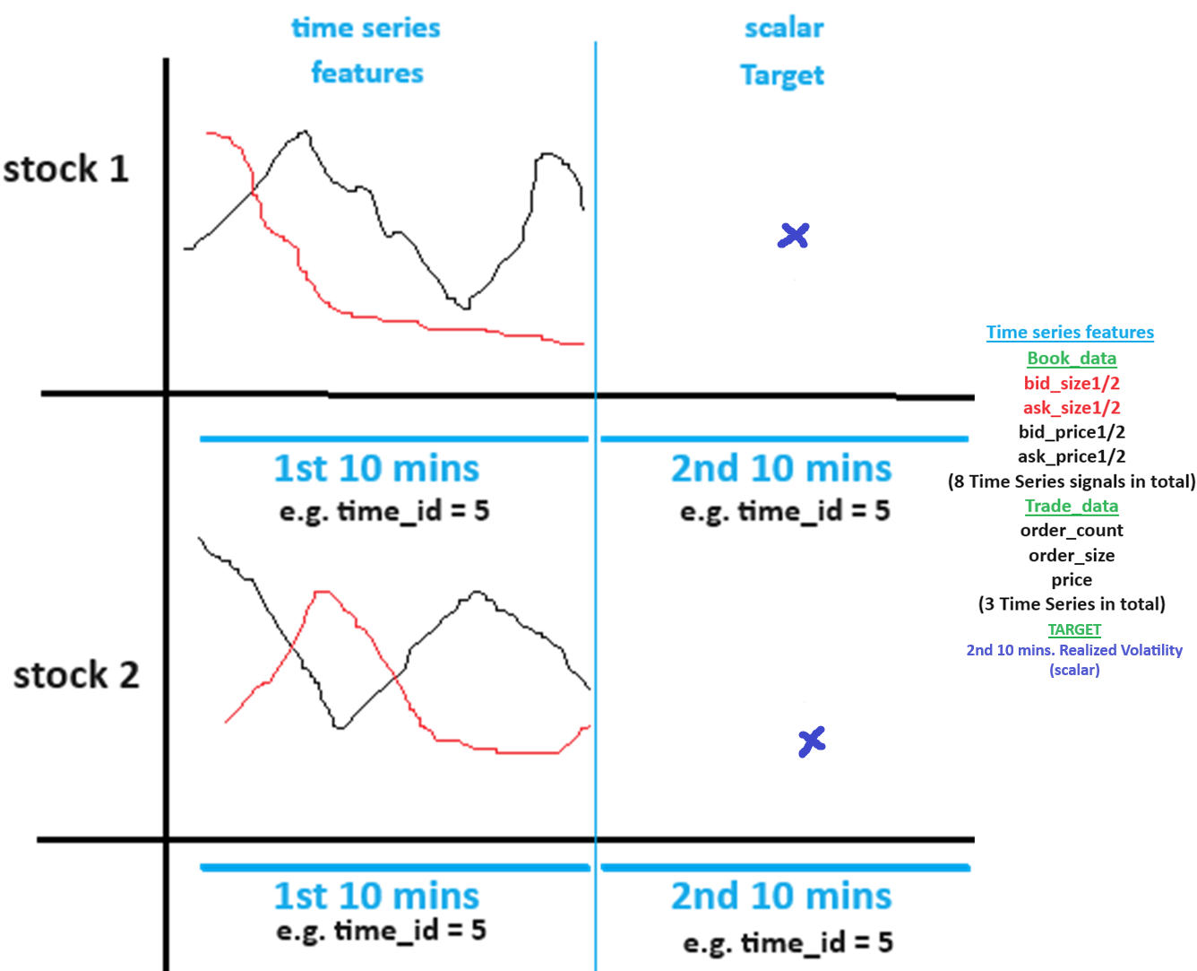
Raw data

Slide 3
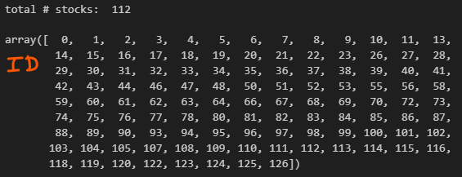
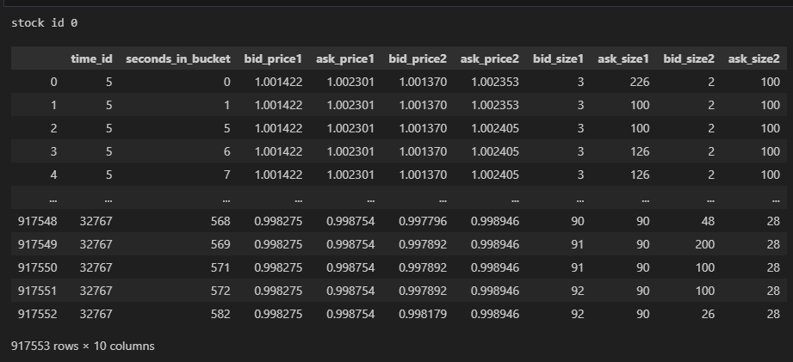
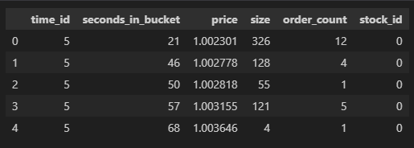
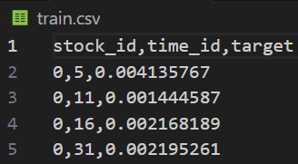
Raw data
Raw Data
book_train.parquet: contains sub-directory with 112 files. Each file e.g. a) below represents a stock and contains columns “time_id”, “seconds_in_bucket”, “bid_price1”, “ask_price1”, “bid_price2”, “ask_price2”, “bid_size1”, “ask_size1”, “bid_size2” ,”ask_size2”. “time_id ” is shuffled and NOT in ascending order. Inside a “time_id” the “seconds_in_bucket” are in ascending order although NOT consecutive.
Stock_id=0 : file schema/metadata shown on right
trade_train.parquet: contains sub-directory with 112 files of same stocks as above. It contains columns “time_id”, “seconds_in_bucket”, “price”, “size”, “order_count”, “stock_id”. “price” refers to actual trade execution price with prices weighted averaged by the order size (number of shares) in each transaction (order_count) in one second. “order_count” refers to the number of unique trade orders taking place. “size” refers to the sum number of shares traded from all the order_counts.
train.csv: contains columns “time_id”, “target”, “stock_id”.
Augmented Raw Data
20_min_volatitliy.parquet: contains sub-directory with two files a) and b) below and each containing columns “stock_id-time_id”, “target”, ”first_10_min_vol”. “first_10_min_vol” column has first 10 mins. calculated realized volatility from inputs in book_train.parquet. “target” column has second 10 mins realized volatility. Inputs to calculation of “target” are unknown.
20_min_volatility_all_stocks.parquet: all stocks concatenated on axis=0
stock_X_20_min_vol.parquet: individual stock X.

Slide 4
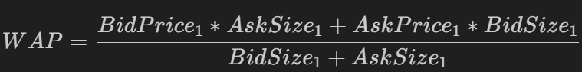
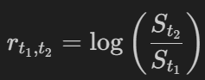
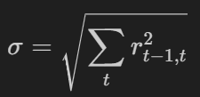
Raw data
Book data
We compute the 1st 10 minutes real vol and merge with 2nd 10 mins real vol in 20_min_volatility_all_stocks.parquet.
WAP (same as VWAP) moves towards bid_price when seller wants to sell large ask_size (weighted more) and conversely towards ask_price if buyer wants to buy more.
S_t2, s_t1 = WAP.
File: data_munging.ipynb

Slide 5
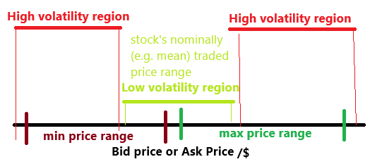
Feature extraction (Raw features)
File: features_eda_within_stocks.ipynb
Book data
All correlations are against target (2nd 10 min real. Vol.)
medium pos. corr. (0.2 – 0.5) max_bid/ask_price
medium neg. corr. (-0.2 – -0.5) min_bid/ask_price
This means having max and min closer together reduces target
From the figure on right, Absolute deviation of price from the nominally traded price (e.g. mean) can be a feature.
Small pos. corr. (0.05 – 0.3) for max_bid/ask_size but some stocks have neg. corr. (outlier stocks 13,31,32,46,51,74,77,108,125 have corr. < -0.1)
Small neg. corr. (0.0– -0.3) for min_bid/ask_size (almost all stocks are neg. corr.)
This means having max and min closer together reduces target
stocks that have neg. corr. for max_bid/ask_size could have lower trading volume so they are not traded as much as the other stocks.
These lower volume trading stocks could be grouped together as a cluster! ??? Or higher volume
Very high pos. corr. Range ask/bid price
Small pos. corr. (0.05 – 0.3) range bid/ask size (outlier stocks 13,31,32,46,51,74,77,108,125 have corr. < -0.1)
These outlier stocks are traded frequently by traders of all sizes so when the range is large all traders (bidders matching askers) orders are filled and therefore less volatile.??
Price is more predictive than size

Slide 6
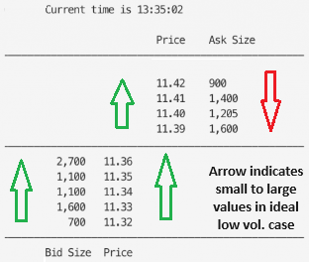
File: features_eda_within_stocks.ipynb
Book data
All correlations are against target (2nd 10 min real. Vol.)
Very high pos. corr. Sum of Absolute Differences (SAD) ask/bid price. SAD is sum of absolute values of first difference between bid/ask prices in a time id. (SAD is less affected by outlier (i.e. a single large first difference) compared to volatility (std. ) which squares deviations)
medium pos. corr. (0.05 – 0.4) Sum of Absolute Differences ask/bid size (outlier stocks 29, 43 < -0.2)
Ask_size x ask_price corr. Is pos. corr. With target (0.0 - 0.2). Generally ask size and ask price are neg. corr. (shown by red and green arrow on picture on right which is true across time as well) Across time/instances because larger ask size will have to ask at a lower price so that volatility is less.
New feature suggestion: bk_level1_2_size_imbalance_feat, volatility is less when level 2 bid_size is less than level 1 bid size across market depth (Not across time) level 2 ask_size is less than level 1 ask size across market depth (Not across time) at a particular time step (e.g. a second in bucket) like shown in the image on right. We are given two levels of the market depth. Sum all the min((level 2 ask/bid size – level 1 ask/bid 1),0) across seconds in the time id. (This quantity is always 0 or negative) Normalize this by the number of data points in this time bucket. Done! Normalization is not good. Sum is better

Slide 7
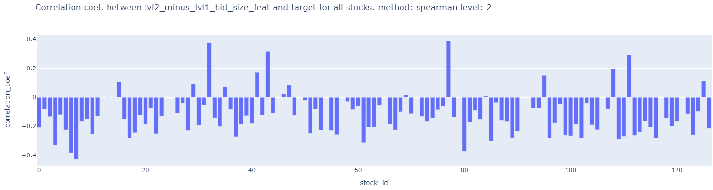
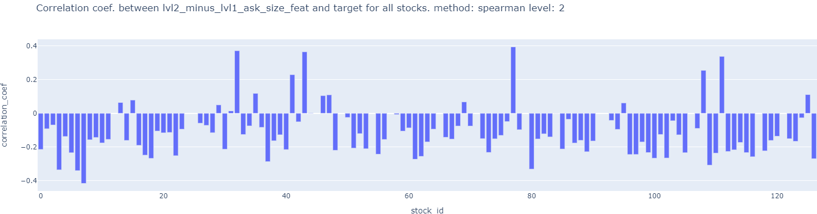
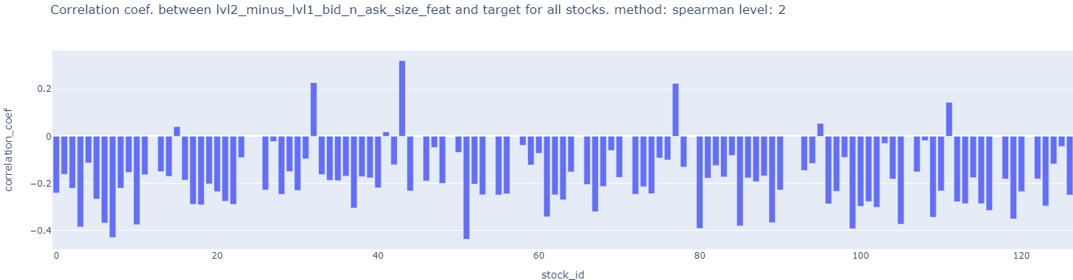
File: features_eda_within_stocks.ipynb
Book data
New feature suggestion: Sum both ask and bid level 2 sizes and subtract from sum of both level 1 ask and bid sizes. Done! Normalization is not good. Sum is better
bid_size x bid_price corr. Is neg. corr. With target (0.0 - -0.2). . Generally bid size and bid price are pos. corr. Across time/instances because larger bid size will have to bid at a higher price so that volatility is less.
Features saved at
bk_level1_2_size_imbalance_feat.pkl

Slide 8
File: features_eda_within_stocks.ipynb
Trade data
All correlations are against target (2nd 10 min real. Vol.)
Medium neg. corr. For min price
Medium pos. corr. For max price
Med. Pos. corr. For max size and max order_count (Redundant with Medium pos. corr. For range size and range order_count) because min size and order_count is poorly corr. With target
Very high corr. Of range price
SAD of price, size, order_count are highly corr.

Slide 9
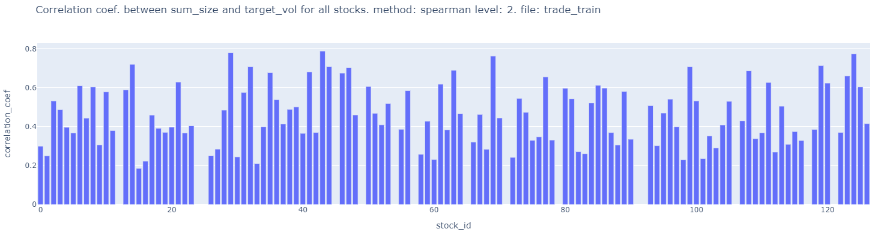
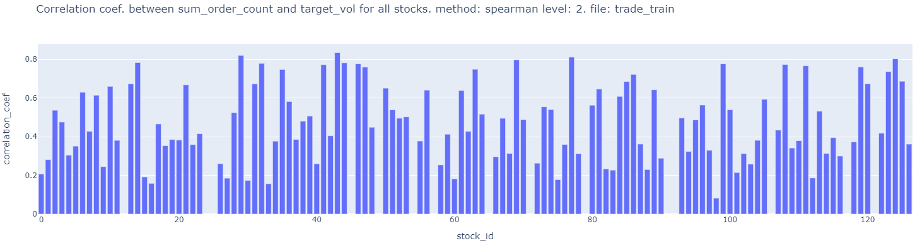
File: features_eda_within_stocks.ipynb
Trade data
New feature suggestion: check corr. Of sum of size within a time id normalized by # seconds in bucket to target.
check corr. Of sum of order_count within a time id normalized by # seconds in bucket to target.

Slide 10
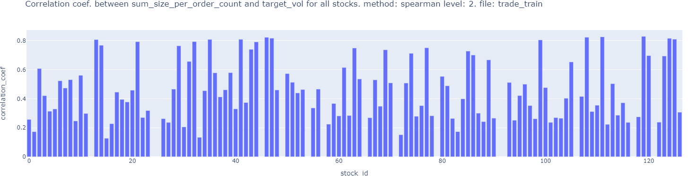
File: features_eda_within_stocks.ipynb
Trade data
New feature suggestion: check corr. Of sum of size per order_count (i.e. size/order_count, average size of an order) within a time id normalized by # seconds in bucket to target. Fewer order_counts trading large sizes leads to less liquidity and more volatility compared to more order_counts and smaller sizes. Done!
Features saved at
trade_sum_size_sum_order_count_sum_size_per_order_count.pkl

Slide 11
File: target_eda_within_stocks.ipynb
Train.csv
Very high corr. Btw. Std_trade_price vs. target
Very high corr. Btw. trade_real_vol vs. target
Small pos. corr. Btw. Std_trade_size vs. target except for stocks 13, 41,46,47, 74, 111, 125 which have neg. corr. (> -0.1)
Small pos. corr. Btw. mean_trade_size vs. target except for stocks 13, 41,46,47, 74, 111, 125 which have neg. corr. (> -0.1)
Medium pos. corr. Btw. Std_trade_order_count vs. target except for 13, 21, 31, 41, 47, 74, 105, 125
Medium pos. corr. Btw. mean_trade_order_count vs. target except for 13, 21, 31,32, 41, 46,47, 74, 105, 108, 111, 125
Do we need to make a separate model for these stocks as they maybe difficult to predict?

Slide 12
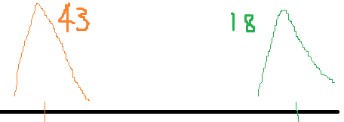
Target Summary statistics
File: target_eda_across_stocks.ipynb
Train.csv
Max # time_ids = 3830: Min # time_ids = 3815. Most stocks have max # time_ids
Largest median 2nd 10-min real. Vol. (i.e. target) = 0.0074 for stock id 18
Smallest median 2nd 10-min real. Vol. (i.e. target) = 0.0011 for stock id 43
Largest mean 2nd 10-min real. Vol. (i.e. target) = 0.0087 for stock id 18
Smallest mean 2nd 10-min real. Vol. (i.e. target) = 0.0015 for stock id 43
Largest std 2nd 10-min real. Vol. (i.e. target) = 0.0050 for stock id 18
Smallest std 2nd 10-min real. Vol. (i.e. target) = 0.0012 for stock id 43
Largest min 2nd 10-min real. Vol. (i.e. target) = 0.0015 for stock id 18
Smallest min 2nd 10-min real. Vol. (i.e. target) = 0.000105 for stock id 31
Largest max 2nd 10-min real. Vol. (i.e. target) = 0.07 for stock id 77
Smallest max 2nd 10-min real. Vol. (i.e. target) = 0.0114 for stock id 43
Stock 18 has largest 2nd 10-min real. Vol.
Stock 43 has smallest 2nd 10-min real. Vol.
Can use separate model for this.

Slide 13
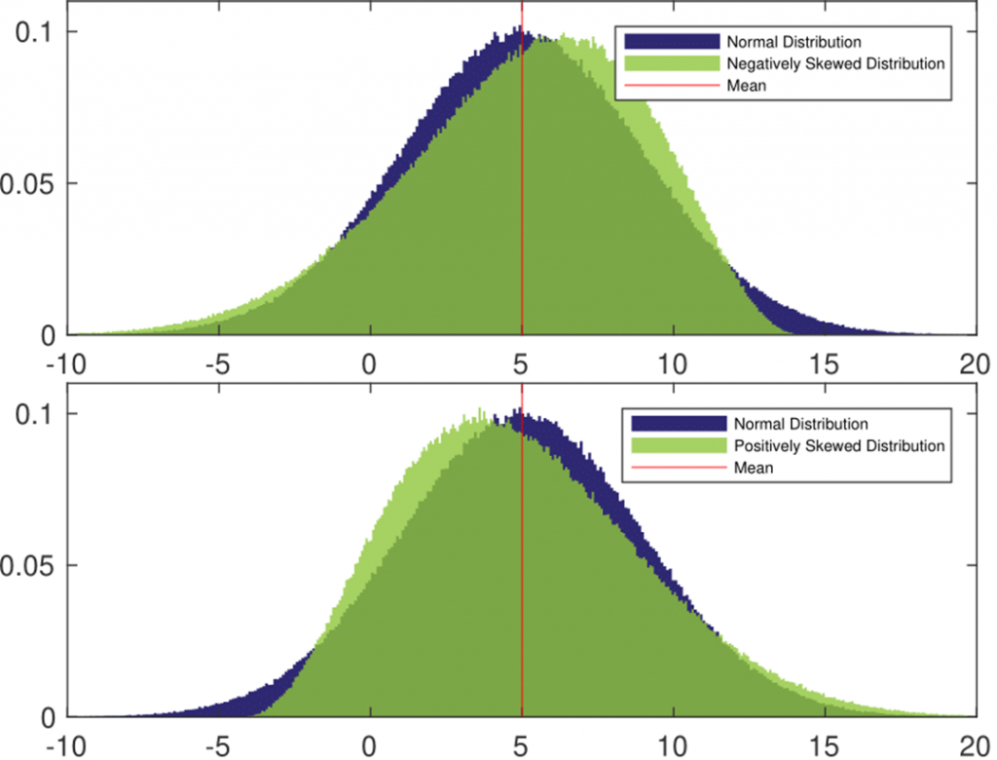
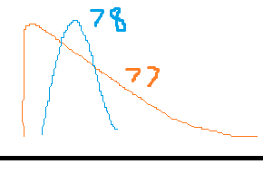
File: target_eda_across_stocks.ipynb
Train.csv
Largest skew 2nd 10-min real. Vol. (i.e. target) = 8.617, 6.08 for stock id 77, 59
Smallest skew 2nd 10-min real. Vol. (i.e. target) = 1.60 for stock id 78
All stocks target are right skew. Asymmetry compared to normal distr. Longer tail on right side. Larger extreme values are more common in larger right skewed distr.
Largest kurt 2nd 10-min real. Vol. (i.e. target) = 148, 97 for stock id 77, 59
Smallest kurt 2nd 10-min real. Vol. (i.e. target) = 3.49 for stock id 78
Fat right tails . Low Kurtosis (<25) for Majority of stocks.
Suggestion: plot these specific stocks densities on the same plot. Plot box plots of these stocks next to each other.
Stock 77 and 18 are similar. St. 77 are skewed right.
Stock 78 looks most normal
Can use separate model for this.

Slide 14
File: target_eda_across_stocks.ipynb
New feature suggestion: Cluster stocks based on distribution by performing Kruskal Wallace test on 112 stocks instead of summary statistics. Then perform post-hoc dunn’s test to get the matrix of similar/dissimilar stocks then do the clustering over this matrix.
Clustering based on stock’s 2nd 10 min real. Vol. (target) distribution.
New feature suggestion: Remove max_vol and min_vol as these can be affected by outliers and use p_75_vol and p_25_vol instead provide a more robust measure of the volatility distribution. Done!
final_robust_sum_stats_target_vol_clusters.pkl

Slide 15
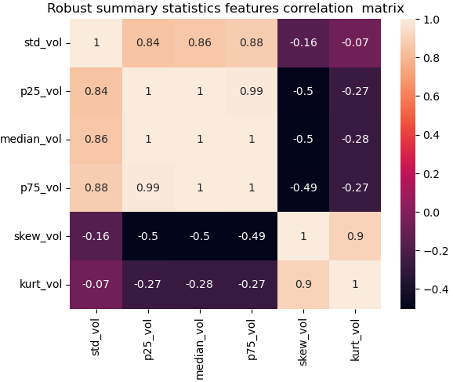
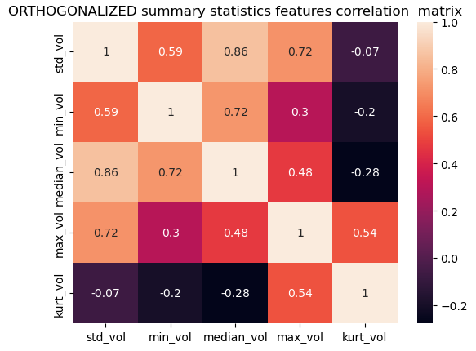
Clustering to form categorical feature of stock groupings (i.e. clusters of similar stocks)
File: target_eda_across_stocks.ipynb
Clustering based on :
Target realized volatility Summary statistical features (i.e. Distributions) :
Non-robust set : std_vol, min_vol, median_vol, max_vol, kurt_vol
Robust feature set : std_vol, p25_vol, median_vol, p75_vol, skew_vol, kurt_vol
Temporal target realized volatility correlation : pearson correlation between stocks for all time_ids.
Highly correlated features lead to double counting in distance calculation so they should be avoided.
As min and max are non-robust measures i.e. subject to outliers. We could use more robust measures like Median Absolute Deviation. After doing (90% winsorization) of outliers. We could use min and max volatilities as features.
But could it be that outliers define the nature of the stock ????
So that they are an important feature?
Maybe not min and max but 5th and 95th percentile?

Slide 16
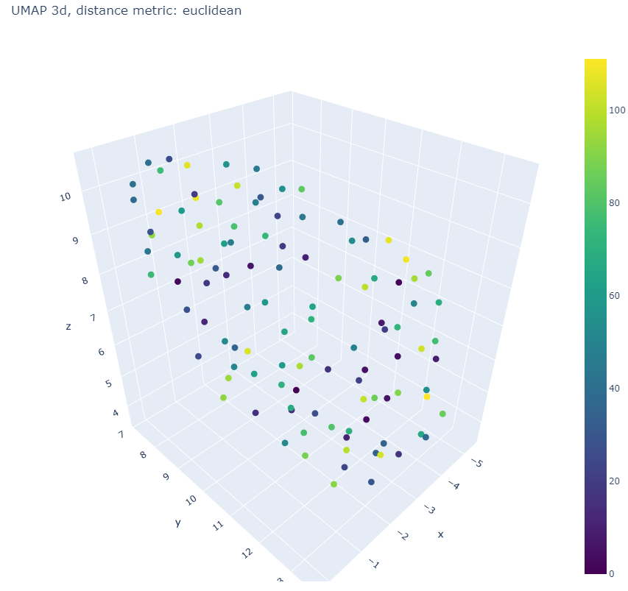
Clustering to form categorical feature of stock groupings
File: target_eda_across_stocks.ipynb
Non-robust set : std_vol, min_vol, median_vol, max_vol, kurt_vol
Visualize in 3d using UMAP for choosing clustering Algo.
PCA can also be used to visualize, However, visualization is only a guide.
The final clustering performance can only be judged by the average silhouette score.
Choose Hier. Agg. clustering as it helps with choosing the numbers of clusters by looking at the dendrogram.
Different linkage methods like “ward”, “single”, “complete”, “median”, “average”, “centroid”, “weighted” to define the distance between data points and clusters to create the linkage matrix.

Slide 17
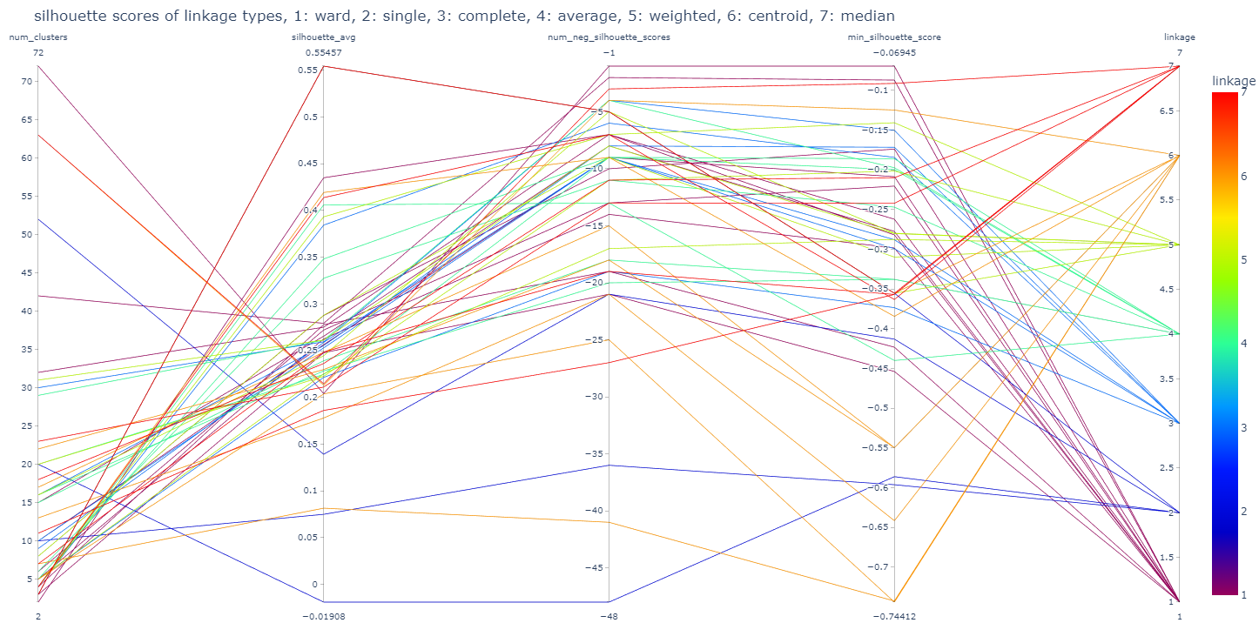
Clustering to form categorical feature of stock groupings
File: target_eda_across_stocks.ipynb

Slide 18
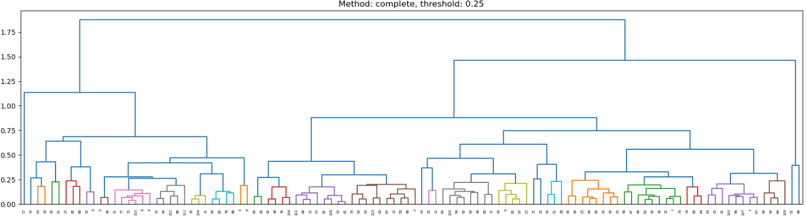
Clustering to form categorical feature of stock groupings
File: target_eda_across_stocks.ipynb
Method: complete, distance metric: Euclidean Was shortlisted to form cluster sizes of 4,10,16,30
Dendrogram helps to choose reasonable clusters by looking at the distance separating the stocks and clusters of stocks as shown on the vertical axis even though clusters maybe of different sizes.

Slide 19
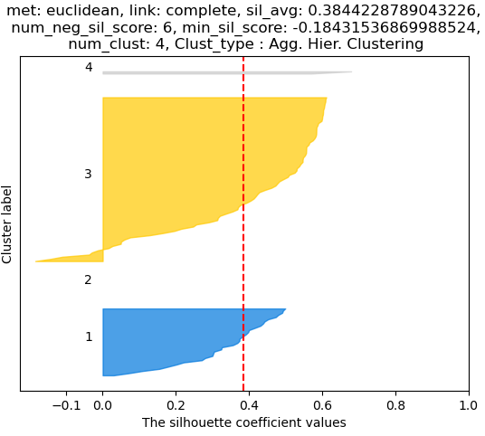
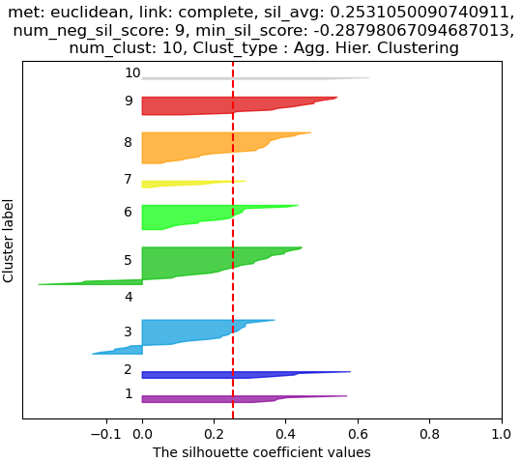
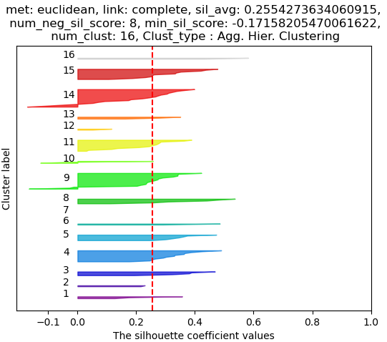
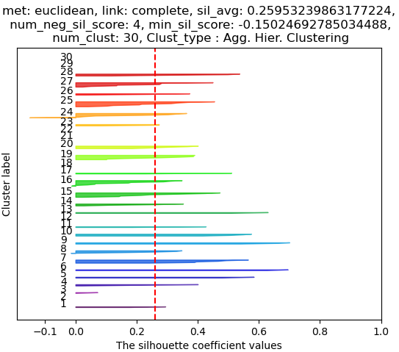
Clustering to form categorical feature of stock groupings
File: target_eda_across_stocks.ipynb
The choice of clustering parameters, tried to reduce the number of negative silhouette score stocks (i.e. stocks in wrong clusters)
Tried to maximize average silhouette score by adjusting different thresholds of the dendrogram for complete linkage.
This clustering forms small, medium and large number of clusters on non-robust features.

Slide 20
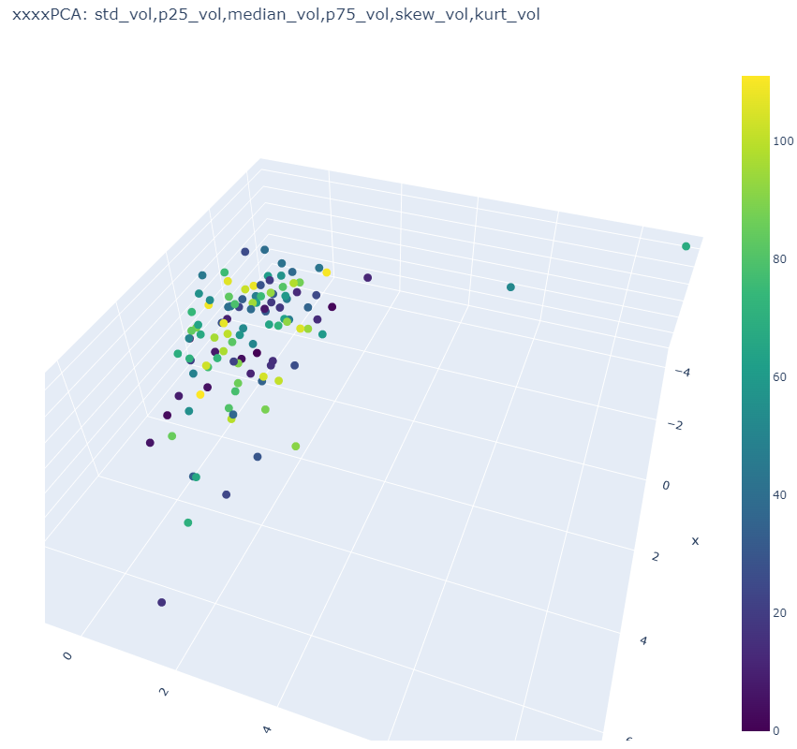
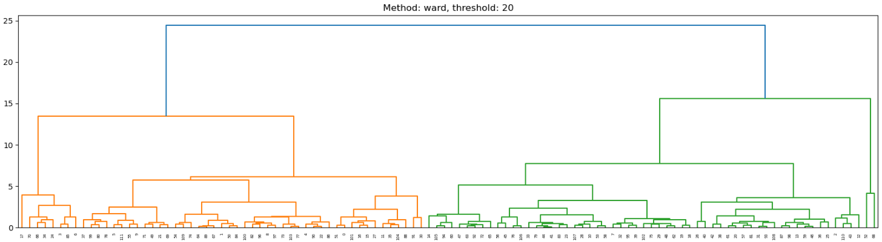
Clustering to form categorical feature of stock groupings
File: target_eda_across_stocks.ipynb
Robust feature set : std_vol, p25_vol, median_vol, p75_vol, skew_vol, kurt_vol
Smaller number of clusters: 2, 4,14,
Two different clustering linkage methods were used for choosing smaller and larger number of clusters, Complete and ward.

Slide 21
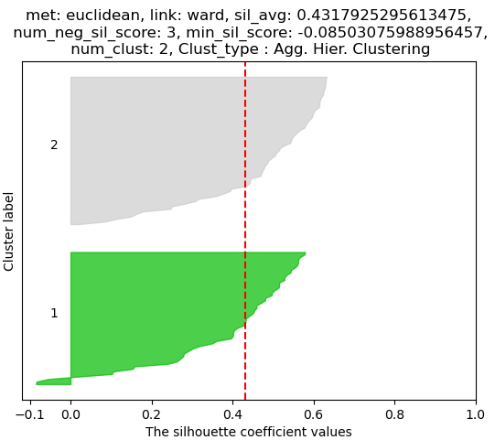
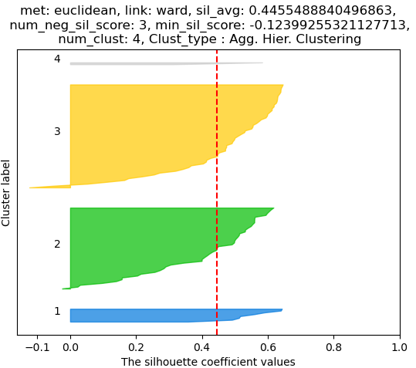
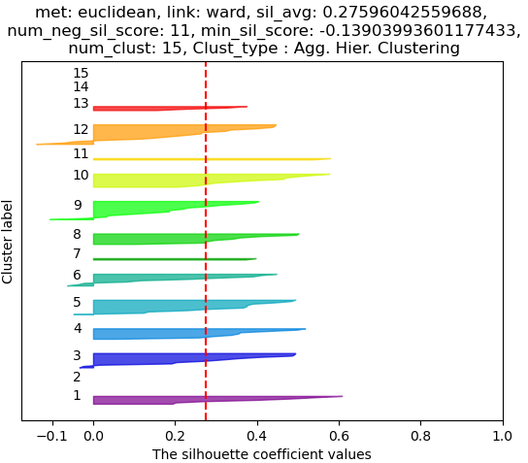
Clustering to form categorical feature of stock groupings
File: target_eda_across_stocks.ipynb
Robust feature set : std_vol, p25_vol, median_vol, p75_vol, skew_vol, kurt_vol
This clustering forms small, number of clusters on non-robust features.

Slide 22
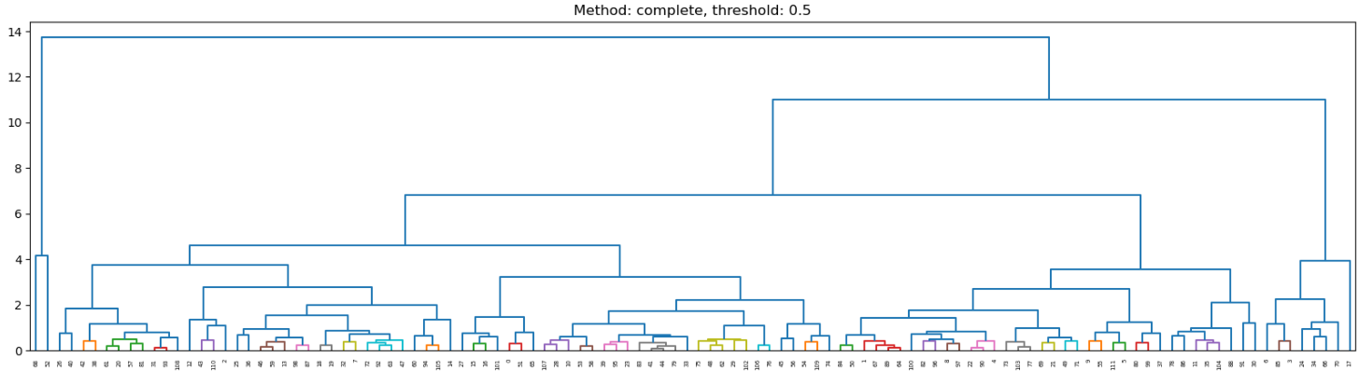
Clustering to form categorical feature of stock groupings
File: target_eda_across_stocks.ipynb
Robust feature set : std_vol, p25_vol, median_vol, p75_vol, skew_vol, kurt_vol
Larger number of clusters: 20, 63

Slide 23
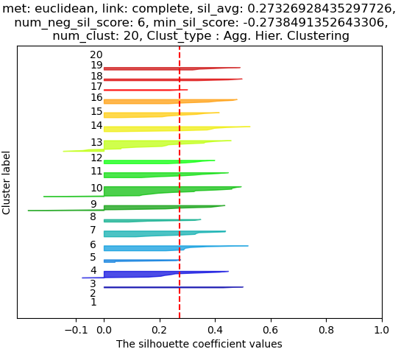
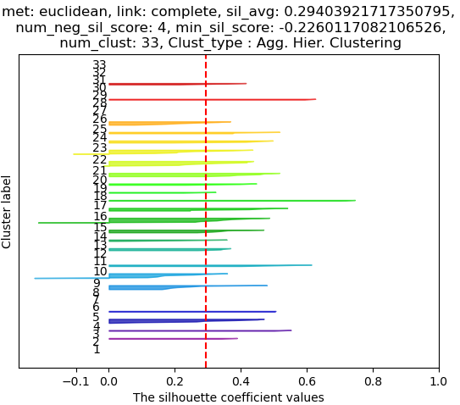
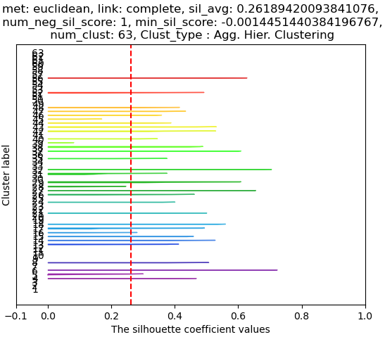
Clustering to form categorical feature of stock groupings
File: target_eda_across_stocks.ipynb
Robust feature set : std_vol, p25_vol, median_vol, p75_vol, skew_vol, kurt_vol
These features are stored in final_robust_sum_stats_target_vol_clusters.pkl
This clustering forms medium and large number of clusters on robust features.

Slide 24
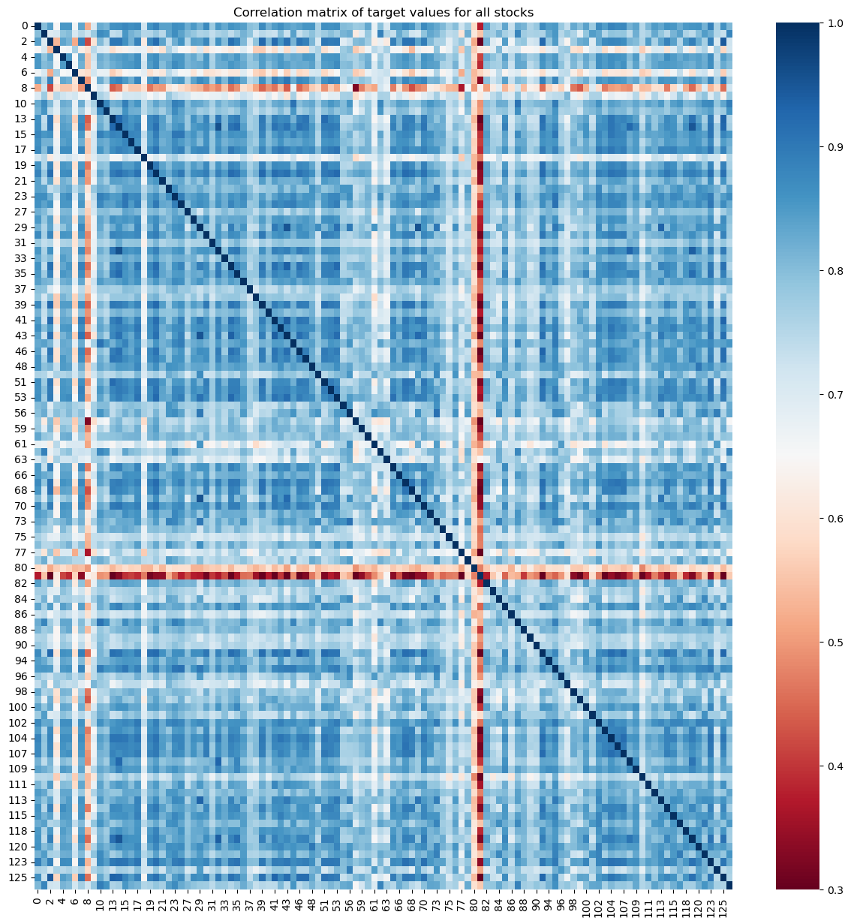
Temporal target realized volatility correlation : pearson correlation between stocks for all time_ids.
File: target_eda_across_stocks.ipynb
Stock 81 may need to be predicted separately. Also stock 8 and 80.
No stocks had negative correlation with each other
Minium corr. (0.209) is between stock 81 and stock 2
Stock 81 has lowest corr. With almost all stocks. 80 has next lowest corr. With almost all stocks. Stock 8 also has comparatively low corr with all other stocks.
There are 14 stock pairs that have a very low corr. (<0.3)
There are 56 stock pairs that have a very low corr. (<0.4)
Maxium corr. (0.96) is between stock 32 and stock 14
There are 162 stock pairs that have a very high corr. (>0.9)
Hier. Agg. Clustering is used on the correlation matrix on the right to identify stock pairs that have similar correlation values. The distance matrix can be formed by 1 - Correlation matrix.
St. 8,80,81 have similar distributions real. Vol. values < 0.03

Slide 25
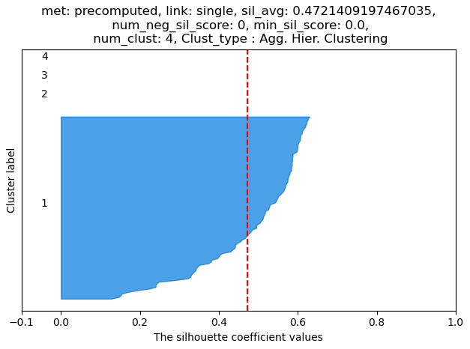
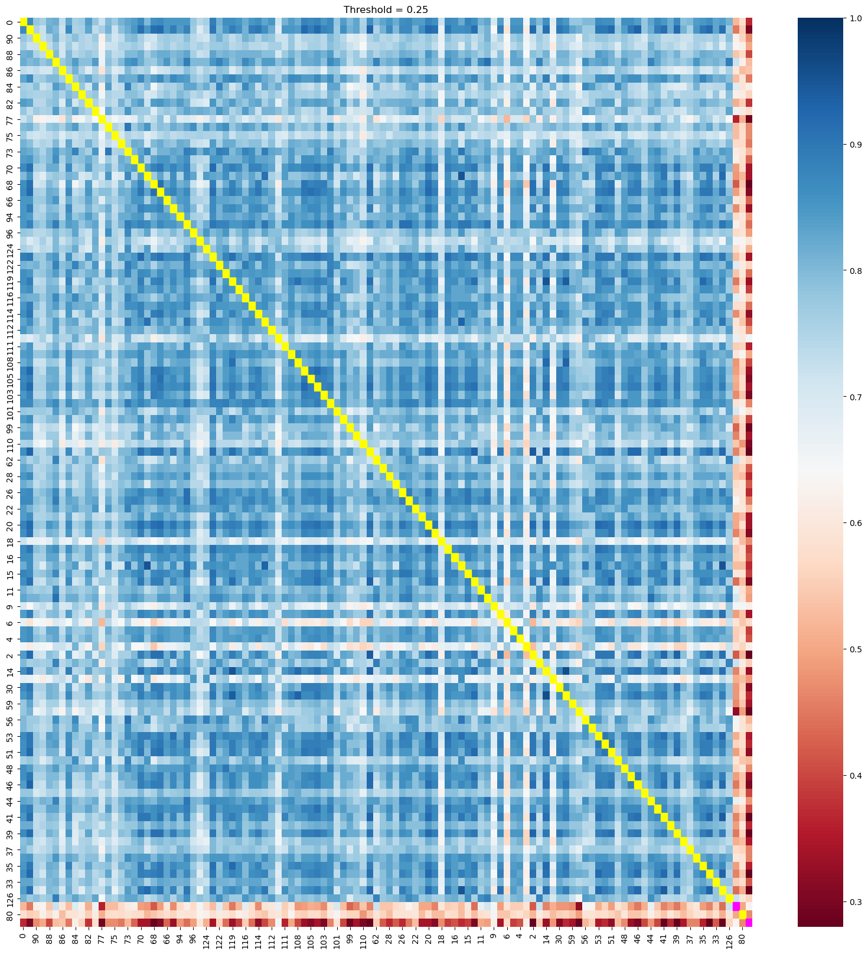
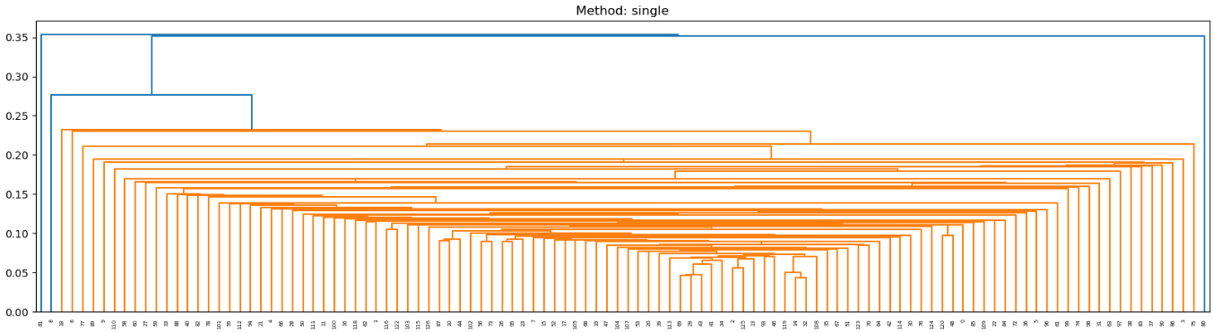
Temporal target realized volatility correlation : pearson correlation between stocks for all time_ids.
File: target_eda_across_stocks.ipynb
Clearly, stocks 3, 6, 8, 80, & 81 have very low correlation to all other stocks so they could be put into a cluster and the rest of the stocks with medium to high corr. to all other stocks into another cluster.
This is the simplest clustering possible but not very useful
as the most stocks are clumped together.
To see finer similarity patterns, we try different linkages.

Slide 26
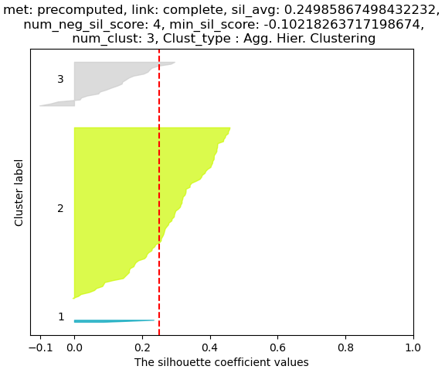
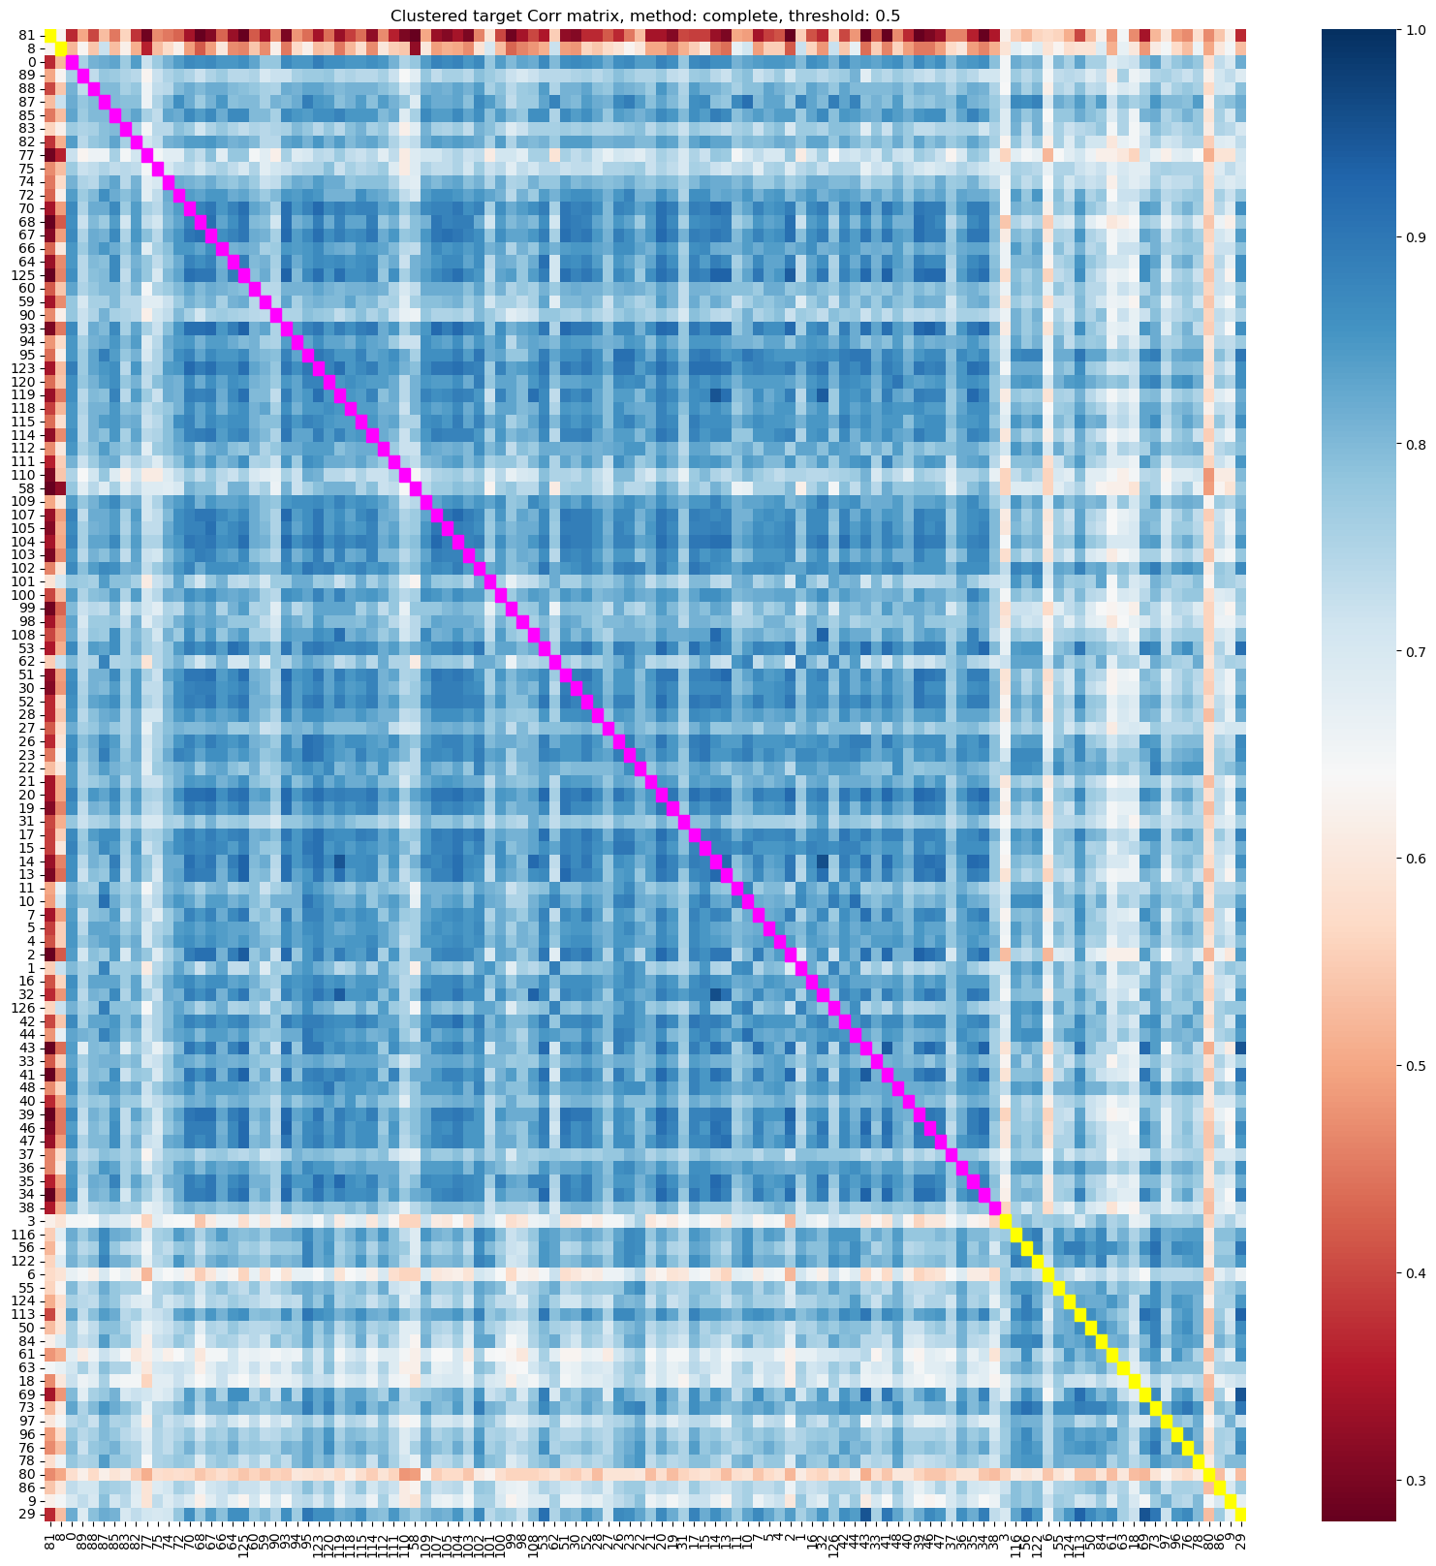
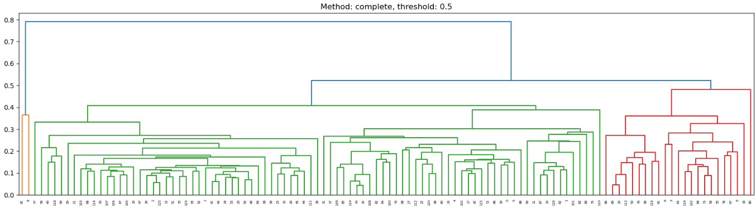
Temporal target realized volatility correlation : pearson correlation between stocks for all time_ids.
File: target_eda_across_stocks.ipynb
We try to guess the number of clusters by using standard number of cluster values around 2, 5, 10, 15, 20, 30, 40, 50, 60, 80. We choose the number of clusters around these that give the best average silhouette score.
The yellow and magenta squares along the diagonal indicate the alternating clusters.

Slide 27
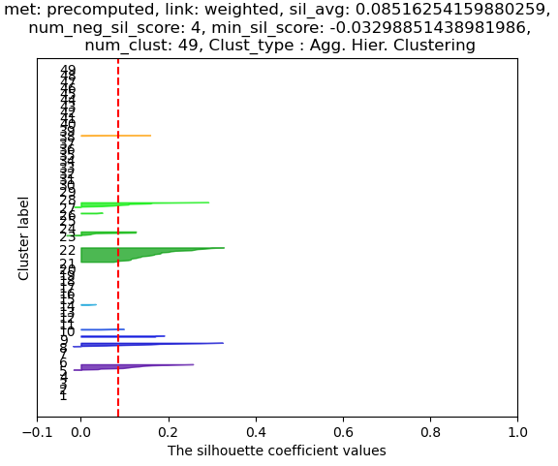
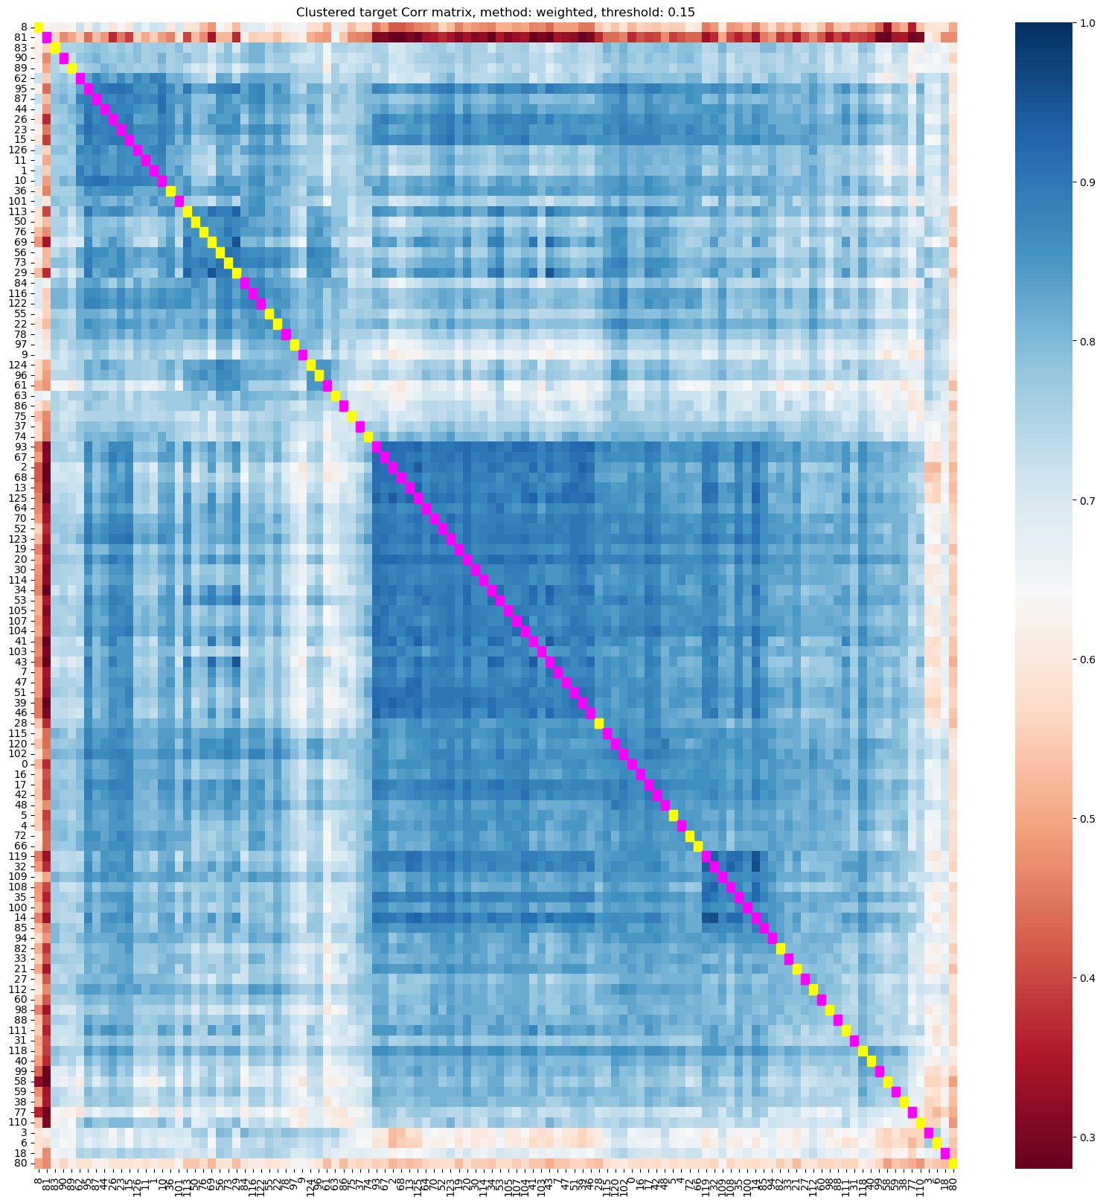
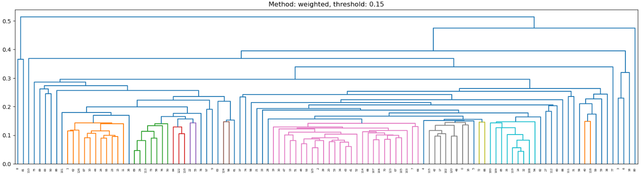
Temporal target realized volatility correlation : pearson correlation between stocks for all time_ids.
File: target_eda_across_stocks.ipynb
The clustering on the corr. Matrix can be visualized as uneven squares forming on the diagonal. These smaller square within the larger square are children of the hierarchy.
This produces 49 clusters.

Slide 28
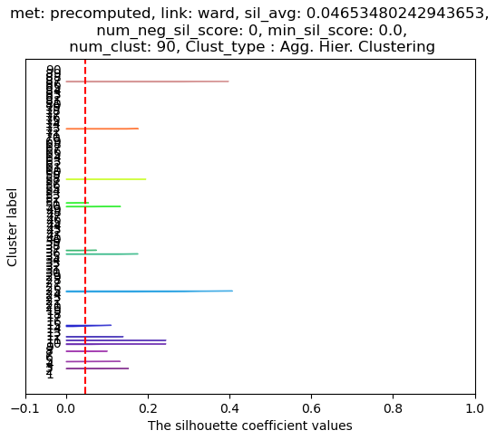
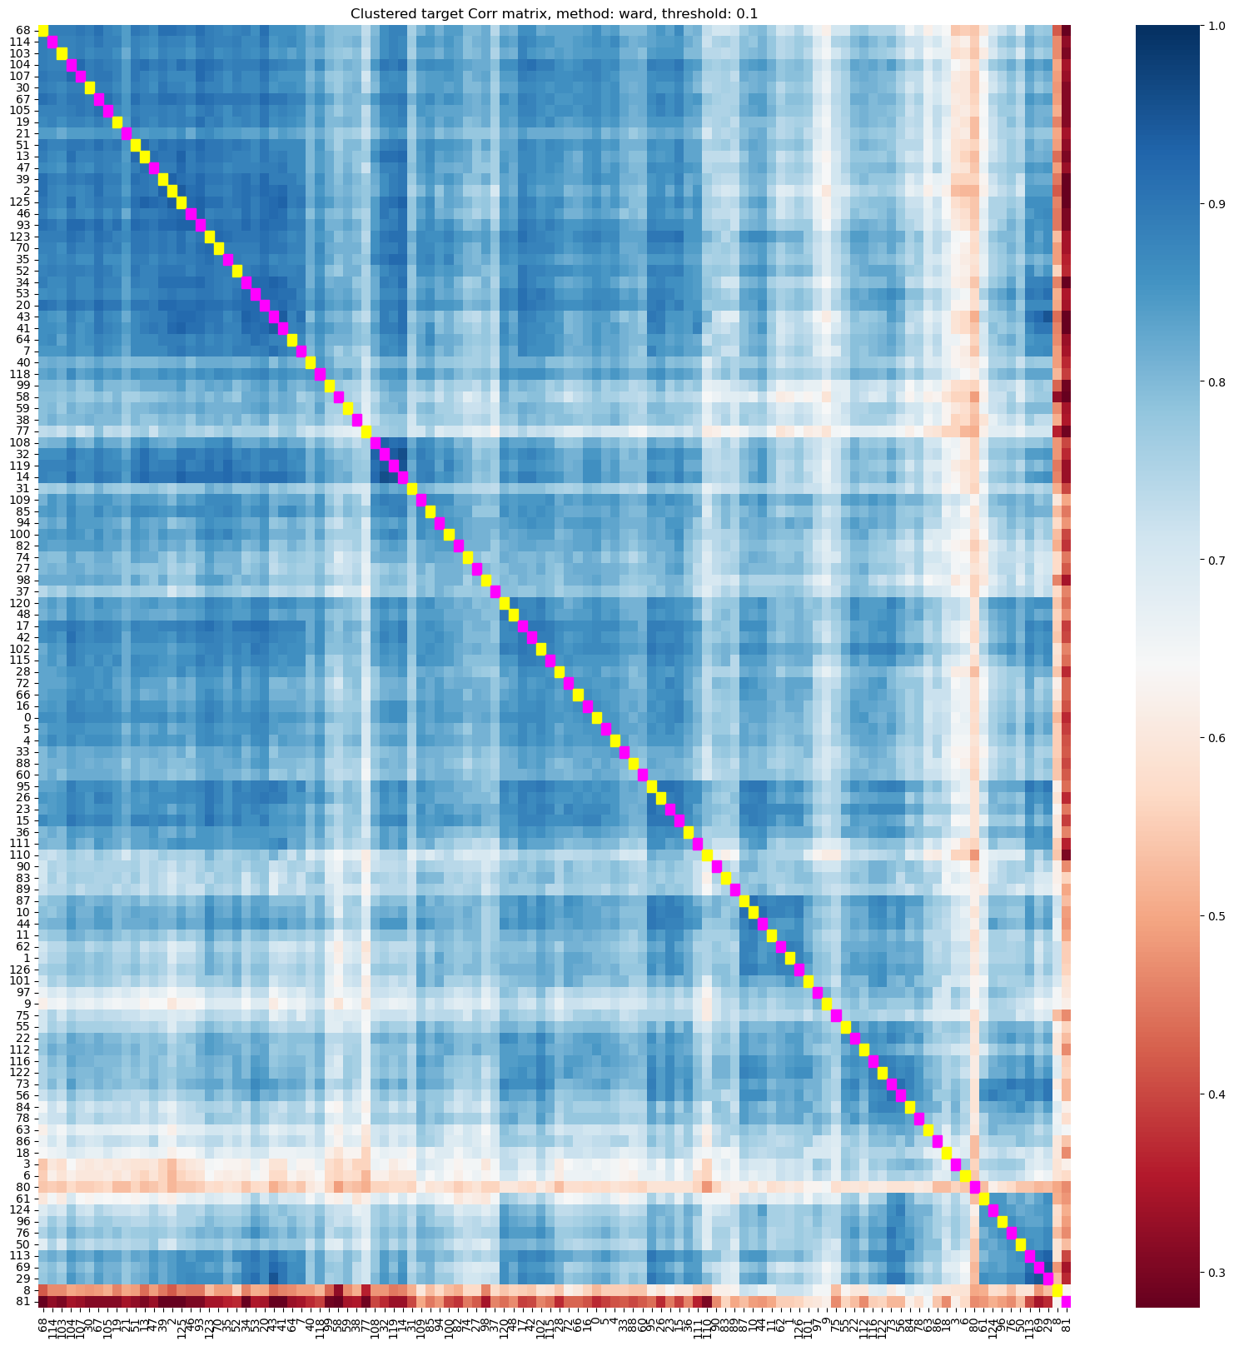
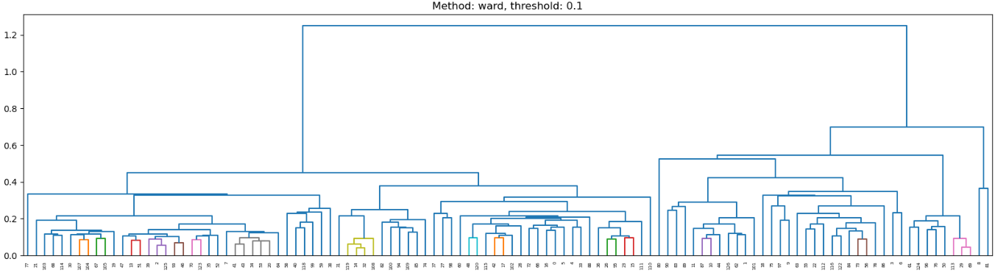
Temporal target realized volatility correlation : pearson correlation between stocks for all time_ids.

Slide 29

Temporal target realized volatility correlation : pearson correlation between stocks for all time_ids.
To select the number of clusters around 10 – 40, a few linkages were tried.
Median and average are chosen.

Slide 30



Temporal target realized volatility correlation : pearson correlation between stocks for all time_ids.

Slide 31



Temporal target realized volatility correlation : pearson correlation between stocks for all time_ids.

Slide 32
Finally, we choose only 4, 10, 26, 49 & 90 clusters and store in final_pear_corr_target_vol_clusters.pkl

Slide 34
Liquidity Features
(Derived features)

Slide 35

Liquidity Features
File: liquidity_features_linux.ipynb
Log transformation shrinks large positive values and extends values less than 1. Log transformation reduces skew of right skewed prices. Log trans. Of right skew price also helps to reduce kurtosis. However, on left skewed prices it increases skew and kurtosis.
log trans. of price centers the distribution around 0 from the normalized value of 1. It uses both positive and negative values which is easier for learning.

Slide 36


Liquidity Features
File: liquidity_features_linux.ipynb
Liquidity describes how much of an asset can be purchased or sold immediately without moving the market (i.e. significant price changes). It is inversely proportional to volatility and bid-ask spread. It is directly proportional to trade volume/ size. If there are many participants willing to trade at low bid-ask spreads, then the asset’s liquidity is said to be high.
There is an inverse relationship between Liq. & Real. Vol.
Liquidity can be a leading indicator of (future) volatility. Monitoring liquidity metrics, such as bid-ask spreads, and trading volume can provide early signals about potential changes in volatility.
We can define a custom formula for liquidity based on the variables provided in the dataset.
The formula should have the following characteristics
High liquidity when bid or ask size is high
High liquidity when deviation of the trading price (realized WAP), x to either bid or ask price is small
High liquidity when more levels to the order book are added(although in only a diminishing way)
BOTH, the bid and ask price should approach this WAP price with time so that trades can happen at this price.
x = VWAP minimizes f(x)

Slide 37


Imbalance in liquidity ?? Or liquidity
We can define the imbalance in liquidity or market pressure between bidders (demand) and askers (supply) using the function, f(wap1) above. The function in plotted on the right. x = wap1, bid_price1 <= wap1 <= ask_price1
The function is convex with a single minimum. At the minimum imbalance in liquidity value ,f, the wap1 price balances the buying and selling pressure. The imbalance (i.e. difference in buying and selling pressure) is minimized, This imbalance is quantified by min {f(wap1)}. i.e. at arg_min_wap1
Therefore, we can find wap1 at the minimum point of this function using the bisection search algorithm.
Check the correlation of 'wap_eqi_price0/1/2/3’ with the target??. If the imbalance is large then realized volatility should be high and vice versa.

Slide 38
Refer to “raw-liquidity-related features data generation ” section in final_summary_report.doc
File: liquidity_features_linux.ipynb
By BUCKETIZING IRREGULARLY SPACED DATA WITHIN FIRST 10 MINS FOR EACH STOCK TO MAKE THEM COMPARABLE ACROSS STOCKS. CREATE GRANULARITY WITHIN FIRST 10-MINS. This is a way to standardize data arriving at irregular seconds.
train_buckets = create_dataSet(st_ids = list(np.unique(train['stock_id'])), dset = 'train')
create_dataset()
- create_stock_data()
create_stock_data()
Next page

Slide 39




create_stock_data()
File: liquidity_features_linux.ipynb
Function: create_stock_data()
Book data
Create ask volume at lvl 1&2 by ask_price * bid_size similarly for bid
Take log of bid/ask prices
Calc. wap1 wap2 using log prices
Find equilibrium price, wap_eqi_price0/1/2 which is price at which supply quantity and demand quantity match and trades happen at this price.
New Feature suggestion: check how trade execution price aligns with equilibrium price or formula WAP. Does their alignment and dissimilarity lead to higher volatility? E.g. computing standard deviation of the ratios of trade execution price and equilibrium price or formula WAP. Do NOT subtract the differently Normalized prices directly. DONE!!

Slide 40

full_book_wap_bisect() Bisection search Algo.
File: liquidity_features_linux.ipynb
Function: create_stock_data()
Book data
This algo. Is tyring to find a quantity very similar to VWAP. We want to mathematically find the equilibrium price, P (i.e. fair price ) Find equilibrium price, wap_eqi_price0/1/2 which is price at which supply pressure and demand pressure match and trades happen at this price.
Through bisection search, we are trying to find the wap1 that results in the minimum value of the function f(wap1), f’(wap1) , f’’(wap1) and so on. We are NOT trying to find the roots of f(wap1), f’(wap1) and so on.
Knowing the function f(Wap1) is convex (u-shaped) Bisection search starts with solution as the midpoint of the two bounds. The derivative at the midpoint is checked and if the derivative is negative then the midpoint lies on the left of the minimum so we shift the left bound to the mid point keeping the right bound the same. Then we take the mid point again of the new bounds. And repeat.
Why use bisection search instead of analytical solution?? Is it because some derivatives do NOT equal zero as in the 3rd derivative?
lvl is used to adjust to find the wap1 at minimum of not only f(wap1) but also minimum of the higher order derivatives f’(wap1), f’’(wap1) and so on.

Slide 41

Plotting Code # Plot the results
plt.figure(figsize=(12, 8))
# Plot equilibrium price
plt.subplot(2, 2, 1)
plt.plot(range(n_step), [p.mean() for p in ps], label='P (Equilibrium Price)')
plt.xlabel('Iteration')
plt.ylabel('Price')
plt.title('Evolution of Equilibrium Price (P)')
plt.legend()
# Plot imbalance function
plt.subplot(2, 2, 2)
plt.plot(range(n_step), [f.mean() for f in fs], label='f (Imbalance Function)', color='orange')
plt.xlabel('Iteration')
plt.ylabel('f (Imbalance)')
plt.title('Evolution of Imbalance Function (f)')
plt.legend()
# Plot inverse distance weights for ixa1
plt.subplot(2, 2, 3)
plt.plot(range(n_step), [ixa.mean() for ixa in ixa1s], label='ixa1', color='green')
plt.xlabel('Iteration')
plt.ylabel('ixa1 (Weight)')
plt.title('Evolution of ixa1')
plt.legend()
# Plot inverse distance weights for ixb1
plt.subplot(2, 2, 4)
plt.plot(range(n_step), [ixb.mean() for ixb in ixb1s], label='ixb1', color='red')
print(ixb1s)
plt.xlabel('Iteration')
plt.ylabel('ixb1 (Weight)')
plt.title('Evolution of ixb1')
plt.legend()
plt.tight_layout()
plt.show()
return p
# Example usage with dummy data
data = {
'log_ask2': [10.5,],
'log_ask1': [10.2, ],
'log_bid1': [9.8, ],
'log_bid2': [9.6, ],
'ask_size2': [100,],
'ask_size1': [200, ],
'bid_size1': [350,],
'bid_size2': [300, ]
}
df = pd.DataFrame(data)
# Run the algorithm with visualization
p = full_book_wap_bisect_plot(df, lvl=1, n_step=22)

Slide 43
create_stock_data()
File: liquidity_features_linux.ipynb
Function: create_stock_data()
Book data
Create ask volume at lvl 1&2 by ask_price * bid_size similarly for bid
Take log of bid/ask prices
Calc. wap1 wap2 using log prices
Find equilibrium price, wap_eqi_price0/1/2 which is price at which supply quantity and demand quantity match and trades happen at this price.
New Feature suggestion: check how trade execution price aligns with equilibrium price or formula WAP. Does their alignment and dissimilarity lead to higher volatility? E.g. computing standard deviation of the ratios of trade execution price and equilibrium price or formula WAP. Do NOT subtract the differently Normalized prices directly.
New Feature suggestion: Employ Bayesian inference to incorporate realized volatility calculated from the order book and realized volatility calculated from trade execution information to compute 2nd 10-min target realized volatility. However, these are static distributions that remain same for all time ids.
Compute liquidity, which is dir. Prop. To volume and inv. Pro. To deviation of equilibrium price from bid/ask price.
Calc. spread, log_spread, inv-spread, size = sum of volume at level1 & 2
Difference in liquidity at the two levels of ask wrt. wap_eqi_price1
Difference in liquidity at the two levels of bid wrt. wap_eqi_price1
Compute returns of wap1/2_log_price, wap_eqi_price0/1
Identify wap2_log_price_ret values when wap2_log_price_ret has no changes (i.e. zero)
# This happens when all orders in level 1 are filled and new orders are placed in level 2

Slide 44
create_stock_data()
File: liquidity_features_linux.ipynb
Function: create_stock_data()
Book data
New Feature suggestion: Employ Bayesian techniques to incorporate both order book and trade execution information.
Compute liquidity, which is dir. Prop. To volume and inv. Pro. To deviation of equilibrium price from bid/ask price.
Calc. spread, log_spread, inv-spread, size = sum of volume at level1 & 2
Difference in liquidity at the two levels of ask wrt. wap_eqi_price1
Difference in liquidity at the two levels of bid wrt. wap_eqi_price1
Compute returns of wap1/2_log_price, wap_eqi_price0/1
Identify wap2_log_price_ret values when wap2_log_price_ret has no changes (i.e. zero)
# This happens when all orders in level 1 are filled and new orders are placed in level 2

Slide 45
create_stock_data()
File: liquidity_features_linux.ipynb
Function: create_stock_data()
Book data
Compute log of liquidity1 &2
Compute Log_liquidity1/2 return
Compute log_spread return
Identify wap1_log_price_ret values when log_liquidity1_ret is increasing and decreasing
Find unique time and stock ids
Bucketize the 600 seconds data into 30 buckets.
Next function is bucketized_summed_data()

Slide 46
bucketized_summed_data()
File: liquidity_features_linux.ipynb
Function: create_stock_data()
Book data
Simply splits the 600 seconds into 30 buckets of 20 seconds length and the sums the data inside this bucket.
wap1_log_price_ret is summed into buckets.
absolute values of wap1_log_price_ret and wap2_log_price_ret are summed into buckets.
Variance of wap1/2_log_price_ret Returns are also summed into buckets. This is aka. squared volatility.
Square Root of above is taken to find volatility in each bucket.
Volatiltiy of wap2_log_price_ret_changes_n_wap1_log_price_ret_constant in each bucket
Absolute values of equil. Price returns, wap_eqi_price0_ret
We also want to see volatility in equilibrium price return, wap_eqi_price0/1_ret which is a measure of volatility in liquidity. Whether liqu. Is changing a lot or less. As this signals upcoming volatility.
Compute volatitlity in wap1_log_price_ret when liquidity1 return is positive. i.e. increases
Compute volatitlity in wap1_log_price_ret when liquidity1 is negative. i.e. decreases
log_liq2_ret_*_wap_eqi_price1_ret_vol_buks : square the product of log_liq2_ret and wap_eqi_price1_ret How to interpret this feature? Can think of this as a compound feature. When both are high/low then value is high/low
exp_log_liq1_ret_*_wap_eqi_price1_ret_vol_buks : Compound feature, # squared wap equilibrium price 1 returns volatility in bucket amplified (> 1) by positive/increasing liquidity returns (through exponent) and diminished ( < 1) by negative/decreasing liquidity returns (through exponent)

Slide 47
bucketized_summed_data()
File: liquidity_features_linux.ipynb
Function: create_stock_data()
Book data
How to interpret this feature?
wap1_log_price_ret_per_spread_sqr_vol_buks: # variance/ squared volatitliy of wap1 price returns per unit of spread # large value indicates volatility Check for inverse relationship
wap1_log_price_ret_per_liq2_vol_buks: # variance/ squared volatitliy of wap1 price returns per unit of liquidity # small value indicates volatilty?
measure of variance/ squared volatility of log liquidity1 returns
measure of variance/ squared volatility of liquidity2 returns
measure of variance/ squared volatility of log spread returns
counting number of data points available in each time bucket

Slide 48
bucketized_time_weighted_avg_data()
File: liquidity_features_linux.ipynb
Function: create_stock_data()
Book data
Suffix with _wavg stands for time weighted average within the bucket. Weighted by the amount of time spent till the next time point. Instead of simply summing like above, we give more weight to more persistent points. This helps to smooth out buckets dominated by noise. Time weighted = x1*(t2 - t1) + x2(t3 - t2) + … / ( (t2 - t1) + (t3 - t2) )
Time weighted average of Wap1/2_log_price
Time weighted average of Wap_eqi_price0/1
# filter out the extremely high and low prices of wap1_log_price by amplifying with postiive and negative exponential of wap1_log_price
# apply time weighted average to the amplified wap1_log_price # amplification of the difference between max and min book_n_trade_data['wavg_wap1_log_price_amp_diff'] = np.exp(book_n_trade_data['wap1_log_price_amp_max_wavg'] - book_n_trade_data['wap1_log_price_amp_min_wavg’]) # it is trying to find the range.
# Do the above two points for wap_eqi_price0
Liquidity1/2_wavg,
Take square root of liquidity2 and find wavg
spread_wavg
Inverse the spread and take wavg
Log the spread/2 and take wavg
Book size/1 take wavg

Slide 49


Trade data
File: liquidity_features_linux.ipynb
Function: create_stock_data()
Trade data
Trade_volume is trade_size * trade_price
Apply bucketized_summed_data() to trade volume
We take square root, cube root, 2/3 root and quart root of trade volume to Variance Reduction, Normalizing Data. The relationship between trade volume and volatility or price impact, is often non-linear. By taking roots, you can linearize these relationships, making them more suitable for linear models. the impact of volume on price changes diminishes as volume increases. Roots reduce the impact of large/outlier values and make them less sensitive to extreme cases. the square root of volume is taken because of the "square root law" of price impact, which suggests that the impact of a trade on price is proportional to the square root of the volume.
Count the number of trades in each time bucket
trade_volume_per_liquidity1_wavg_buks : trade_volume_buks / liquidity1_wavg
trade_volume_per_liquidity1_wavg_buks : trade_volume_buks / liquidity2_wavg
Ask/bid_liq1_diff_wavg: Time weighted average of difference between ask's level 1 and level 2 liquidity
Finally, this function returns book_n_trade_data dictionary with 47 raw liquidity features with each having shape of (time_id x stock_id x bucket) = 3830, 112, 30

Slide 50
Check corr. Btw. Target and raw liq. Feat.
Done!
Check the correlation between target and each of the 47 raw liquidity feature’s (take median across 30 buckets.)
See appendix for all graphs for problematic features.
Almost no corr. Btw. Following feat. With target for all stocks
wap1_log_price_ret_buks, wap1_log_price_wavg, wap2_log_price_wavg, wap_eqi_price0_wavg, wap_eqi_price1_wavg,
Very High pos. corr. Btw. Following feat. With target for all stocks
wap1_log_price_ret_abs_vol_buks, wap2_log_price_ret_abs_vol_buks, 'wap1_log_price_ret_sqr_vol_buks',
'wap2_log_price_ret_sqr_vol_buks’, 'wap1_log_price_ret_vol_buks’, 'wap2_log_price_ret_vol_buks’ wap2_logprice_ret_changes_n_wap1_logprice_ret_constant_sqr_vol_buks 'wap_eqi_price0_ret_abs_vol_buks', 'wap_eqi_price0_ret_sqr_vol_buks', 'wap1_log_price_ret_pos_log_liq_ret_sqr_vol_buks', 'wap1_log_price_ret_neg_log_liq_ret_sqr_vol_buks', 'wap_eqi_price1_ret_sqr_vol_buks', 'log_liq2_ret_*_wap_eqi_price1_ret_vol_buks', 'exp_log_liq1_ret_*_wap_eqi_price1_ret_vol_buks', 'exp_log_liq1_ret_*_wap_eqi_price1_ret_vol_buks_2’, 'wap1_log_price_ret_per_liq2_vol_buks’ wavg_wap1_log_price_amp_diff, wavg_eqi_price0_amp_diff, spread_wavg, log_spread_wavg, log_spread2_wavg
Very High neg. corr. Btw. Following feat. With target for all stocks
Liquidity1_wavg, Liquidity2_wavg, root_liquidity2_wavg, inv_spread_wavg, bid_liq1_diff_wavg,
Mix of pos. and neg. corr. With target for different stocks
Book_size1_wavg, Book_size_wavg,
Mix of med. To high pos. corr. for different stocks
'wap1_log_price_ret_per_spread_sqr_vol_buks’ , 'log_liquidity1_ret_sqr_vol_buks’, 'log_liquidity2_ret_sqr_vol_buks’, ‘book_delta_count_buks, trade_volume_buks, sqrt_trade_volume_buks, cube_root_trade_volume_buks, trade_volume_p2/3_buks, quart_root_trade_volume_buks, trade_count_buks, trade_volume_per_liquidity1_wavg_buks, trade_volume_per_liquidity2_wavg_buks, ask_liq1_diff_wavg,
Mix of low. To high pos. corr. for different stocks
'log_spread_ret_sqr_vol_buks’

Slide 51
Check the min, max and range of values for each of raw liq. Feature to see the scale of each feature. They all have different scales so they need to be normalized.
exp_log_liq1_ret_*_wap_eqi_price1_ret_vol_buks AND exp_log_liq1_ret_*_wap_eqi_price1_ret_vol_buks_2(same as previous) Min: 0.0, Max: 15.4314858288986
log_liquidity1_ret_sqr_vol_buks Min: 0.0, Max: 216.44643432321027
wap1_log_price_ret_per_spread_sqr_vol_buks Min: 0.0, Max: 63893.42029636643
wavg_wap1_log_price_amp_diff Min: 0.9999999999351177, Max: inf
wavg_wap_eqi_price0_amp_diff Min: 0.9999999999406891, Max: inf
liquidity1_wavg Min: 0.850008628347739, Max: 2997063.2110014684
liquidity2_wavg Min: 0.1854020731394554, Max: 108551400.92072429
spread_wavg Min: 2.514241494843901e-05, Max: 0.03775830443923237
ask_liq1_diff_wavg Min: -2925519.34853724, Max: 1525556.4992372217
bid_liq1_diff_wavg Min: -1590983.930454508, Max: 2545604.6237271978
Others vary from -0.5 to 0.5

Slide 52
Clustering Analysis of raw liq. features
•Naturally, we can cluster stocks on features that have high pos. or neg. corr. With the target.
Clustering is done by the perform_clustering() function
Feat. wap1_log_price_ret_buks has poor corr. With the target so it should not be used for clustering.

Slide 53
perform_clustering()
Feat. coming has dim. time_id x stock_id (30 buckets are already agg. Using mean)
Feat. Is standardized.
Feat. Corr. Across stocks is calc. C.shape = 112x112. Fischer transform arctanh() of all 112 corr values is done to make their dist. Normal. Diagonals of C matrix is filled with mean corr of each stock to every other stock.
PCA of the Feat. Matrix, (time_id x stock_id) is carried out. However, n_components is set to 112 (i.e. full feat. Dim.) Here time_id is treated like n_samples and stock_id is treated like n_features.
We compute the PCs using .fit() and get a matrix of shape (n_components x n_features) i.e. (n_components x stock_ids)
We eliminate some of the components (dimensionality reduction) by multiplying with singular values (contracted by ^0.5) this is an automatic way of choosing largest n_components.
We transpose this matrix PCs matrix to get (n_features x n_components) matrix and we do clustering on this transposed matrix. Here each feature is the stock_id and it is represented by the n_components
We could also take another approach and compute the score matrix (dimensionality reduced data matrix after applying the PCs.)

Slide 54
perform_clustering()
As GMM is used, it’s only good if each Gaussian cluster has enough points so it maybe better to use this for fewer number of clusters with many points inside each. Limit number of clusters to 10.

Slide 58
Feature Engineering
train_features = generate_features(train_buckets)
train_features['target'] = read_targets_from_df(train, train_buckets['stock_ids'], train_buckets['time_ids'])
generate_features(train_buckets)
get_cohesion_features()
get_misc_features()
get_simple_features()
read_targets_from_df()
train_feat_df = merge_features_to_df(train_features, train, [f for f in list(train_features.keys()) if ('time_id' not in f)])
merge_features_to_df()

Slide 59
generate_features(train_buckets)
For all the features in this func. We agg. Along the bucket axis.
We take log to reduce the right skew and large kurtosis and make it more normal, . Before we can take log the feature has to be positive so we square the feature before taking the mean and then square root afterwards. Squaring can also help to prevent feature values canceling out within the bucket. This brings back the scale and also results in positive numbers.
final_features['wap1_log_price_ret_vol'] = np.mean(train_buckets['wap1_log_price_ret_vol_buks']**2, 2, keepdims=True)**0.5
# (log liquidity ret x equi_price1_volatility) / wap1 price volatitliy = a kind of liquidity adjusted volatility # take log as the value is around 1. log gives negative sign to values less than 1 and positive sign to values greater than 1 # check if greater than or less than wap1 price volatility
final_features['log_liq2_ret_*_wap_eqi_price1_ret_vol'] = np.log(np.mean(train_buckets['log_liq2_ret_*_wap_eqi_price1_ret_vol_buks']**2, 2, keepdims=True)**0.5/final_features['wap1_log_price_ret_vol'])

Slide 60
generate_features(train_buckets)
TO interpret the feature, train_buckets['log_liq2_ret_*_wap_eqi_price1_ret_vol_buks'] : wap equilibrium price 1 returns volatitlity in bucket amplified (> 1) by positive/increasing liquidity returns (through exponent) # and diminished ( < 1) by negative/decreasing liquidity returns (through exponent)
We divide this by final_features['wap1_log_price_ret_vol'] to see its compare if it is above or below this.
final_features['exp_log_liq1_ret_*_wap_eqi_price1_ret_vol'] = np.log(np.mean(train_buckets['exp_log_liq1_ret_*_wap_eqi_price1_ret_vol_buks']**2, 2, keepdims=True)**0.5/final_features['wap1_log_price_ret_vol'])
# average out along the buckets axis
final_features['wap1_log_price_ret_per_liq2_vol']
# ratio of mean of last 15 buckets to mean of first 15 buckets within a time id. ratio > 1 means increasing trend. ratio < 1 means decreasing trend
final_features['log_liq2_ret_*_wap_eqi_price1_ret_vol_15_ratio']
final_features['wap1_log_price_ret_per_liq2_vol_15_ratio']
final_features['wap1_log_price_ret_per_spread_sqr_vol_15_ratio']
final_features['exp_log_liq1_ret_*_wap_eqi_price1_ret_vol_15_ratio']

Slide 61
generate_features(train_buckets)
final_features['wap2_logprice_ret_changes_n_wap1_logprice_ret_constant_sqr_vol_15_ratio']
# ratio of mean of last 15 buckets to mean of first 15 buckets within a time id. ratio > 1 means increasing trend. ratio < 1 means decreasing trend # median across all stocks (dimension 1) for that time id. This feature only has time id dimension.
final_features['wap2_logprice_ret_changes_n_wap1_logprice_ret_constant_sqr_vol_15_ratio_median_stock'].
final_features['log_liq2_ret_*_wap_eqi_price1_ret_vol_15_ratio_median_stock']
final_features['wap1_log_price_ret_per_spread_sqr_vol_15_ratio_median_stock']

Slide 62
generate_features(train_buckets)
# (liquidity x equi_price1_volatility) / wap1 price volatitliy = a kind of liquidity adjusted volatility # take log as the value is around 1. log gives negative sign to values less than 1 and positive sign to values greater than 1 # check if greater than or less than wap1 price volatility # volatitlity in wap1_log_price_ret when liquidity1 is negative. i.e. decreases divided by wap1_log_price_ret_vol
# volatitlity in wap1_log_price_ret when liquidity1 is negative. i.e. decreases divided by wap1_log_price_ret_vol
final_features['wap2_logprice_ret_changes_n_wap1_logprice_ret_constant_sqr_vol']
# volatitlity in wap1_log_price_ret when liquidity1 is positive. i.e. increases divided by wap1_log_price_ret_vol
final_features['wap1_log_price_ret_pos_log_liq_ret_sqr_vol']
# difference between volatitlity in wap1_log_price_ret when liquidity1 is positive and negative. i.e. increases minus decreases
final_features['wap1_log_price_ret_pos-neg_log_liq_ret_sqr_vol']

Slide 63
generate_features(train_buckets)
# uses feature wap1_log_price_ret_buks from bucket 0 to 30 of a time id, i.e. all. # uses wap1_log_price_ret_buks from bucket 10 to 30 of a time id, I.e. last two thirds # uses wap1_log_price_ret_buks from bucket 20 to 30 of a time id, i.e. last one third
get_cohesion_features(train_buckets, final_features, ffrom=0/10/20)

Slide 64
get_cohesion_features(train_buckets, final_features, ffrom=0/10/20)
# variance along time_id axis, mean along bucket axis and then square root, # basically standard deviation of wap1_log_price_ret_buks in each stock. This is like (overall) volatility over entire time period for each stock.
stocks_overall_wap1_log_price_ret_vol = np.mean( np.var(wap1_log_price_ret_buks, 0,keepdims=True), 2, keepdims=True)**0.5 # shape of (1,112,1)
# normalize the variance of wap1_log_price_ret_buks by overall volatility, assume that mean of wap1_log_price_ret_buks is zero
wap1_log_price_ret_normalized = wap1_log_price_ret_buks[:,:,ffrom:]/stocks_overall_wap1_log_price_ret_vol # shape of (3830,112,30)

Slide 65
get_cohesion_features(train_buckets, final_features, ffrom=0/10/20)
# variance of wap1_log_price_ret_normalized along stock id axis, mean along bucket axis and then square root, shape of (3830,1,1) and then normalized by wap1_log_price_ret_vol (shape 3830 x 112, 1). dim 1 is broadcasted to dim 112
# multiply by stocks_overall_wap1_log_price_ret_vol (shape = (1,112,1) ) to get the original variance of wap1_log_price_ret_buks to get final shape of (3830,112,1)
# multiplication by stocks_overall_wap1_log_price_ret_vol (overall volatility) is the reverse of normalization
# Volatility across stocks at each time id divided by volatility at each stocks and time id = factor of overall volatility across stocks contributed by each stock in each time id.
# This is multiplied by overall volatility across time for each stock.
# It is just a scalar giving importance to amount of variance across all time.
# ati = across time, ast = across stock, # shape of (3830,112,1),
final_features['wap1_lprice_ret_vol_ati_*_wap1_lprice_ret_vol_ast_per_wap1_lprice_ret_vol'+ buk]

Slide 66
get_cohesion_features(train_buckets, final_features, ffrom=0/10/20)
# shape of (3830,112,1), market is np.mean(wap1_log_price_ret_normalized, 1, keepdims=True). IT is just mean over all stock ids.
final_features['wap1_lprice_ret_vol_ati_*_wap1_lprice_ret_avg_ast_per_wap1_lprice_ret_vol'+ buk]
# deviation from market is np.mean(wap1_log_price_ret_normalized, 1, keepdims=True) minus wap1_log_price_ret_normalized
final_features['wap1_log_price_ret_normalized*mean_centered_per_wap1_lprice_ret_vol' + buk]

Slide 67
get_misc_features(train_buckets, final_features)
# average out along the time ids and buckets axis # shape of (1,112,1)
stocks_overall_trade_volume
stocks_overall_liquidity2
# average out along the buckets axis # shape of (3830,112,1)
stocks_overall_wap1_log_price_ret_vol

Slide 68
get_misc_features(train_buckets, final_features)
# (vol[:,:, 0:]/liq2[:,:, 0:]*l2/s) = (vol[:,:, 0:] / s ) / (liq2[:,:, 0:]) / l2), standardized volume divided by standardized liquidity2
# (vol[:,:, 0:]/liq2[:,:, 0:]*l2/s)**(1/8) , diminish the effect of outliers, or reduce large values
# np.nanmean( (vol[:,:, 0:]/liq2[:,:, 0:]*l2/s)**(1/8), (1,2), keepdims=True) , average over stock_id and buckets axis
# (s/l2*np.nanmean( (vol[:,:, 0:]/liq2[:,:, 0:]*l2/s)**(1/8), (1,2), keepdims=True)**8) , destandardize and then take the power of 8 to undo the effect of 1/8
# (s/l2*np.nanmean( (vol[:,:, 0:]/liq2[:,:, 0:]*l2/s)**(1/8), (1,2), keepdims=True)**8)**.5 , take the square root as it is liquidity of level 2
# (s/l2*np.nanmean( (vol[:,:, 0:]/liq2[:,:, 0:]*l2/s)**(1/8), (1,2), keepdims=True)**8)**.5/v1 , divide by wap1_log_price_ret_vol to check > 1
# for greater than wap1_log_price_ret_vol or wap1_log_price_ret_vol < 1 for less than wap1_log_price_ret_vol
# log detects > 1 or < 1
final_features['soft_stock_mean_tvpl2_:0' ] = np.log( (stocks_overall_trade_volume/stocks_overall_liquidity2*np.nanmean( (trade_volume_buks[:,:, 0:]/liquidity2_wavg[:,:, 0:]*stocks_overall_liquidity2/stocks_overall_trade_volume)**(1/8), (1,2), keepdims=True)**8)**.5/stocks_overall_wap1_log_price_ret_vol)
final_features['soft_stock_mean_tvpl2_:10']
final_features['soft_stock_mean_tvpl2_:20']

Slide 69
get_misc_features(train_buckets, final_features)
# same as above but only using the last bucket of liquidity2
final_features['soft_stock_mean_tvpl2_liqf' ]
final_features['soft_stock_mean_tvpl2_liqf_volf10']
final_features['soft_stock_mean_tvpl2_liqf_volf20']
# np.mean(vol1[:,:,25:]**2,2,keepdims=True) ,squared wap1_log_price_ret_vol_buks average for last 5 buckets # np.mean(vol1[:,:,:15]**2,2,keepdims=True) , squared wap1_log_price_ret_vol_buks average for first 15 buckets # np.nanmedian( np.mean(vol1[:,:,25:]**2,2,keepdims=True) / np.mean(vol1[:,:,:15]**2,2,keepdims=True),1,keepdims=True) , median of ratio along stock_id axis , shape of (3830,1,1) # square root to get back standard deviation / volatility # log to detect > 1 or < 1
Any feature with “v1” in its name refers to “wap1_log_price_ret_vol_buks” feature
final_features['v1proj_25_15'] = np.log( np.nanmedian( np.mean(wap1_log_price_ret_vol_buks[:,:,25:]**2,2,keepdims=True) / np.mean(wap1_log_price_ret_vol_buks[:,:,:15]**2,2,keepdims=True),1,keepdims=True)**.5 )
# same as above but only for wap1_log_price_ret high correlation stocks
final_features['v1proj_25_15_lr1_high_corr_stocks’]
final_features['v1proj_25_15_vol1_high_corr_stocks’]
final_features['v1proj_25_lr1_high_corr_stocks’] ## when the 2nd bucket number is not given it means all the buckets are taken using :
final_features['v1proj_25_vol1_high_corr_stocks']

Slide 70
get_misc_features(train_buckets, final_features)
# average of log_spread_ret_sqr_vol_buks over all buckets
final_features['lsvol']
# average of log_liquidity1_ret_sqr_vol_buks over all buckets
final_features['liqvol1’]
# average of log_liquidity2_ret_sqr_vol_buks over all stock ids and buckets, smean is mean over stocks.
final_features['liqvol1_smean’]
# average of log_liquidity1_ret_sqr_vol_buks over all buckets for each cluster # is grouped by cluster and then median is taken. repeat the median value for each stock in the same cluster. shape of (3830,112,1) However, the issue with these clusters is tha they are formed using wap1_log_price_ret which has very low corr. With the target.
final_features['liqvol1_smean_c3’]
# average of log_liquidity2_ret_sqr_vol_buks over all buckets
final_features['liqvol2']

Slide 71
Cluster_agg()
# all stocks in a cluster are aggregated along stock_id axis
# repeat the aggregated value for each stock in the cluster

Slide 72
get_misc_features(train_buckets, final_features)
# average of feature over all buckets
final_features['trade_count’]
final_features['root_trade_count’]
# average of squre root of trade_count over all stock ids and all buckets
final_features['root_trade_count_smean’]
# average of square root of number of data points in a bucket over all buckets # book_delta_count_buks counts number of data points available in each time
final_features['root_book_delta_count’]
# average of square root of trade_count over all buckets for each cluster # is grouped by cluster 1 and then mean is taken. repeat the mean value for each stock in the same cluster. shape of (3830,112,1) However, the issue with these clusters is that they are formed using wap1_log_price_ret which has very low corr. With the target.
final_features['root_trade_count_smean_c1']

Slide 73
get_misc_features(train_buckets, final_features)
final_features['root_trade_count_smean_c2’]
final_features['root_trade_count_smean_c3’]
# variance of square root of trade_count over all buckets for each cluster
final_features['root_trade_count_var’]
# ratio of average trade_count in last 15 buckets to first 15 buckets
final_features['trade_count_15_15’]
# ratio of average square root trade_count in last 15 buckets to first 15 buckets
final_features['root_trade_count_15_15’]
# median of ratio of mean wap1_log_price_ret_vol_buks in last bucket to first 15 buckets along stock_id axis, shape of (3830,1,1) . Similar naming for other buckets
final_features['v1proj_29_15’]
final_features['v1proj_20']

Slide 74
get_misc_features(train_buckets, final_features)
final_features['v1proj_25’]
final_features['v1proj_29’]
# 25% quantile of ratio of mean wap1_log_price_ret_vol_buks in last 2 buckets to all buckets along stock_id axis, shape of (3830,1,1)
final_features['v1proj_29_q1']
# 75% quantile of ratio of mean wap1_log_price_ret_vol_buks in last 2 buckets to all buckets along stock_id axis, shape of (3830,1,1)
final_features['v1proj_29_q3']
# 25% quantile of ratio of mean wap1_log_price_ret_vol_buks in last 5 buckets to all buckets along stock_id axis, shape of (3830,1,1)
final_features['v1proj_25_q1’]
# 75% quantile of ratio of mean wap1_log_price_ret_vol_buks in last 5 buckets to all buckets along stock_id axis, shape of (3830,1,1)
final_features['v1proj_25_q3']

Slide 75
get_misc_features(train_buckets, final_features)
# 25%/75% quantile of ratio of mean wap1_log_price_ret_vol_buks in last 2 buckets to first 15 buckets along stock_id axis, shape of (3830,1,1)
final_features['v1proj_29_15_q1’]
final_features['v1proj_29_15_q3’]
# 25%/75% quantile of ratio of mean wap1_log_price_ret_vol_buks in last 5 buckets to first 15 buckets along stock_id axis, shape of (3830,1,1)
final_features['v1proj_25_15_q1’]
final_features['v1proj_25_15_q3’]
# std of ratio of mean wap1_log_price_ret_vol_buks in last 5 buckets to first 15 buckets along stock_id axis, shape of (3830,1,1)
final_features['v1proj_25_15_std’]
final_features['v1proj_29_15_std’]
final_features['v1proj_20_std’]

Slide 76
get_misc_features(train_buckets, final_features)
final_features['v1proj_25_std’]
final_features['v1proj_29_std']
# difference between 75% and 25% quantile of ratio of mean wap1_log_price_ret_vol_buks in last 2 buckets to all buckets along stock_id axis, shape of (3830,1,1)

Slide 77
get_misc_features(train_buckets, final_features)
# CHECK IF there are more than 100 stocks (if wap1_log_price_ret_vol_buks.shape[1]>100) # Basically, all features calculated above are repeated and aggregated for each cluster using mean, median and std etc.. However, the issue with these clusters is that they are formed using wap1_log_price_ret which has very low corr. With the target.
final_features['v1proj_25_c1’]
final_features['v1proj_25_c2]
final_features['v1proj_25_c3’]
final_features['v1proj_25_c4’]
final_features['v1proj_25_c5’]
Refer to soft_stock definition given in page 62. It is same as that but we use cluster_agg on the calculated soft_stock before multiplying back (stocks_overall_trade_volume/stocks_overall_liquidity2) and then dividing by stocks_overall_wap1_log_price_ret_vol
Only the cluster and buckets change each time. .. However, the issue with these clusters is that they are formed using wap1_log_price_ret which has very low corr. With the target.

Slide 78
get_misc_features(train_buckets, final_features)
final_features['soft_stock_mean_tvpl2_c1'] = np.log( stocks_overall_trade_volume/stocks_overall_liquidity2*cluster_agg( np.nanmean( (trade_volume_buks[:,:, 0:]/liquidity2_wavg[:,:, 0:]*stocks_overall_liquidity2/stocks_overall_trade_volume)**(1/8), 2, keepdims=True), wap1_log_price_ret_cluster1, np.mean)**8**.5/stocks_overall_wap1_log_price_ret_vol)
final_features['soft_stock_mean_tvpl2_c2’]
final_features['soft_stock_mean_tvpl2_c3']
final_features['soft_stock_mean_tvpl2_10_c1’]
final_features['soft_stock_mean_tvpl2_10_c2’]
final_features['soft_stock_mean_tvpl2_10_c3’]
final_features['soft_stock_mean_tvpl2_20_c1’]
final_features['soft_stock_mean_tvpl2_20_c2’]
final_features['soft_stock_mean_tvpl2_20_c3’]

Slide 79
get_misc_features(train_buckets, final_features)
Simply take ratio of means of wap1_log_price_ret_vol_buks across different buckets. Pass this to cluster_agg() function using cluster wap1_log_price_ret_cluster1 where standard deivation of values in same cluster are taken. However, the issue with these clusters is that they are formed using wap1_log_price_ret which has very low corr. With the target.
final_features['v1proj_25_c1_std'] = np.log( cluster_agg( np.log(np.mean(wap1_log_price_ret_vol_buks[:,:,25:]**2,2,keepdims=True) / np.mean(wap1_log_price_ret_vol_buks[:,:,: ]**2,2,keepdims=True)), wap1_log_price_ret_cluster1, np.nanstd)**0.5 )
final_features['v1proj_25_c2_std’]
final_features['v1proj_25_c3_std’]
final_features['v1proj_25_c4_std']
final_features['v1proj_25_c5_std']
Simply take ratio of means of wap1_log_price_ret_vol_buks across different buckets. Pass this to cluster_agg() function using cluster log_wap1_log_price_ret_vol_clusters1 where median of values in same cluster are taken. This log_wap1_log_price_ret_vol_clusters1 has good corr. With target.
final_features['v1proj_25_vc1']

Slide 80
get_misc_features(train_buckets, final_features)
final_features['v1proj_25_vc2']
final_features['v1proj_25_vc3']
final_features['v1proj_25_vc4’]
Same as above but cluster aggregation using log_quart_trade_volume_clusters1, “vvcx” in feature naming below
final_features['v1proj_25_vvc1'] = np.log( cluster_agg(np.mean(wap1_log_price_ret_vol_buks[:,:,25:]**2,2,keepdims=True) / np.mean(wap1_log_price_ret_vol_buks[:,:,: ]**2,2,keepdims=True), log_quart_trade_volume_clusters1, np.median)**0.5 )
final_features['v1proj_25_vvc2’]
final_features['v1proj_25_vvc3']

Slide 81
get_misc_features(train_buckets, final_features)
Find difference between mean log_spread2_wavg between two buckets to 15 and from 25. cluster_agg() using wap1_log_price_ret_cluster1 and take median. However, the issue with these clusters is that they are formed using wap1_log_price_ret which has very low corr. With the target.
final_features['v1spprojt15f25_c1'] = np.log( cluster_agg( - np.mean(log_spread2_wavg[:,:,:15], (2),keepdims=True) + np.mean(log_spread2_wavg[:,:,25:], (2),keepdims=True), wap1_log_price_ret_cluster1, np.median) )
final_features['v1spprojt15f25_c2’]
final_features['v1spprojt15f25_c3’]
final_features['v1spprojt15f25_c4’]
Same as above but using log_wap1_log_price_ret_vol_clusters1 good clusters.
final_features['v1spprojt15f25_vc1’]
final_features['v1spprojt15f25_vc2’]
final_features['v1spprojt15f25_vc3’]

Slide 82
get_misc_features(train_buckets, final_features)
# ratio of average of all buckets trade_volume to average of all buckets liquidity2, shape of (3830,1,1) name 'tvpl2_rmed2v1’ could mean trade volume per liquidity 2 _ ratio median dimension 2(buckets) v stands for wap1 and 1 stands for dimension 1 (stocks dim) lf is left or start of bucket
final_features['tvpl2_rmed2v1'] = np.log( np.median( ( np.mean( trade_volume_buks, 2, keepdims=True)**.5 / np.mean( liquidity2_wavg[:,:, 0:]**.5, 2, keepdims=True))/stocks_overall_wap1_log_price_ret_vol, 1, keepdims=True))
final_features['tvpl2_rmed2v1lf25’]
final_features['tvpl2_rmed2v1lf29’]
# ratio of average of all buckets trade_volume to average of last 5 buckets liquidity2, shape of (3830,1,1)
final_features['tvpl2'] = np.log( np.mean( trade_volume_buks, 2, keepdims=True)**.5/np.mean( (liquidity2_wavg)**.5, (2), keepdims=True)/stocks_overall_wap1_log_price_ret_vol)
# ratio of average of all buckets trade_volume to average of last 20 buckets liquidity2, shape of (3830,112,1)
final_features['tvpl2_liqf10']

Slide 83
get_misc_features(train_buckets, final_features)
# ratio of average of all buckets trade_volume to average of last 10 buckets liquidity2, shape of (3830,112,1)
final_features['tvpl2_liqf20’]
# ratio of average of all buckets trade_volume to average of last 1 bucket liquidity2, shape of (3830,112,1)
final_features['tvpl2_liqf29’]
# ratio of average of all time ids and buckets trade_volume to average of all bucket liquidity2, shape of (3830, 112, 1)
final_features['tvpl2_smean_vol' ] = np.log( np.mean( trade_volume_buks, (0,2), keepdims=True)**.5/np.mean( (liquidity2_wavg[:,:, 0:])**.5, (2), keepdims=True)/stocks_overall_wap1_log_price_ret_vol)
# ratio of average of all time ids and buckets trade_volume to average of last 20 bucket liquidity2, shape of (3830, 112, 1)
final_features['tvpl2_smean_vol_liqf10’]
final_features['tvpl2_smean_vol_liqf20’]
final_features['tvpl2_smean_vol_liqf29']

Slide 84
get_misc_features(train_buckets, final_features)
Ratio of liquidity2_wavg for different buckets
final_features['v1liq2projt5'] = np.log( ( np.mean( liquidity2_wavg[:,:, : 5]**(1/8), 2, keepdims=True)**8 / np.mean( liquidity2_wavg[:,:,28: ] , 2, keepdims=True) )**(1/2) )
final_features['v1liq2projt10’]
final_features['v1liq2projt20']
# ratio of average of first 10/20 buckets liquidity2_wavg to average of last 1 buckets liquidity2, shape of (3830,112,1)
final_features['liqt10rf29’]
final_features['liqt20rf29']
# median along stock id axis, how liquidity2_wavg changes/ratio in first 10 bins to last 5 bins. shape of (3830,1,1)
final_features['v1liq2sprojt10f25'] = np.log( np.median( np.mean(liquidity2_wavg[:,:,:10]**.125, (2),keepdims=True)**8/ np.mean(liquidity2_wavg[:,:,25: ]**.125, (2),keepdims=True)**8 , 1, keepdims=True)**(1/2) )
final_features['v1liq2sprojt5f25']

Slide 85
get_misc_features(train_buckets, final_features)
# median along stock id axis, of difference of mean of all buckets log_spread2_wavg to mean of last 1 bucket log_spread2_wavg , shape of (3830,1,1)
final_features['v1spprojt10f29'] = np.median( - np.mean(log_spread2_wavg[:,:, : ], (2),keepdims=True) + np.mean(log_spread2_wavg[:,:,29: ], (2),keepdims=True) , 1, keepdims=True)
final_features['v1spprojt15f25’]
final_features['v1spprojt15f29']
# 25%/75% quantile along stock id axis, of ratio of mean of first 15 buckets log_spread2_wavg to mean of last 1 bucket log_spread2_wavg , shape of (3830,1,1)
final_features['v1spprojt15f29_q1’]
final_features['v1spprojt15f29_q3']
# 25%/75% quantile along stock id axis, of ratio of mean of first 15 buckets log_spread2_wavg to mean of last 5 bucket log_spread2_wavg , shape of (3830,1,1)
final_features['v1spprojt15f25_q1’]
final_features['v1spprojt15f25_q3']

Slide 86
get_misc_features(train_buckets, final_features)
# 25%/75% quantile along stock id axis,of ratio of mean of all buckets log_spread2_wavg to mean of last 1 bucket log_spread2_wavg , shape of (3830,1,1)
final_features['v1spprojtf29_q1’]
final_features['v1spprojtf29_q3’]
# 25%/75% quantile along stock id axis,of ratio of mean of all buckets log_spread2_wavg to mean of last 5 bucket log_spread2_wavg , shape of (3830,1,1)
final_features['v1spprojtf25_q1’]
final_features['v1spprojtf25_q3’]

Slide 87
get_simple_features(train_buckets, final_features, 'wap1_log_price_ret_vol', ffrom=0/10/20/25)
# average of wap1_log_price_ret_buks in all buckets of a time id. Then average over all time ids. Then take square root, shape of (1,112,1)
# wap1_log_price_ret_vol and then normalized by wap1_log_price_ret_vol (shape 3830 x 112, 1), is it 1 for ffrom=0? This is just telling fraction of mean over certain buckets to the overall mean over all buckets
final_features[name + suffix] = np.log( np.mean(wap1_log_price_ret_vol[:,:,ffrom:]**2, 2, keepdims=True)**0.5/final_features['wap1_log_price_ret_vol’])
The following is actually the stock’s median. That is normalized by means wap1_log_price_ret_vol of across time ids and stock ids
final_features[name+'stock_mean'+suffix] = np.log(stocks_overall_wap1_log_price_ret_mean*np.median( np.mean( wap1_log_price_ret_vol[:,:,ffrom:]/stocks_overall_wap1_log_price_ret_mean, 2, keepdims=True), 1, keepdims=True)/final_features['wap1_log_price_ret_vol'])

Slide 88
get_misc_features(train_buckets, final_features)
# standardize wap1_log_price_ret_vol by dividing by mean of wap1_log_price_ret_vol across all time ids
final_features['vol1_mean'] = np.log(final_features['wap1_log_price_ret_vol']/np.nanmean(final_features['wap1_log_price_ret_vol'], 0, keepdims=True))
# std of ratio of mean of last 15 buckets to mean of first 15 buckets within a time id. ratio > 1 means increasing trend. ratio < 1 means decreasing trend, shape of (1,112,1)
final_features['mean_half_delta’]
# std of difference between last bin and first bin of log_spread_wavg, shape of (1,112,1)
final_features['mean_half_delta_lsprd’]
# take log
final_features['log_wap1_log_price_ret_vol'] = np.log(final_features['wap1_log_price_ret_vol'])

Slide 89

read_targets_from_df()
# returns a matrix of shape (len(t), len(s)) with target values as entries
merge_features_to_df()
# some time ids are missing in the df, so df is smaller than dfz # 428960 to 428932, 151 to 152 # suffix _x and _y are added for clashing columns during merge
Finally, train_feat_df # shape of (428932 rows × 228 columns) (time_id=3830,stock_id= 112 cross joined and features= 228)

Slide 90

Explore the Target
Individually, Each stock’s target boxplot distribution is shown below. All stock’s 2nd 10 min. real. volatility is right skewed. Almost every stock has outliers.

Slide 91



Explore the Target
Target is right skewed as shown below. As most points are very close to each other around small values it maybe hard to distinguish individual values in prediction. At the same time for large values the target has many gaps where there are no data points. Taking the log transformation helps to spread out the target values around small values and bring the make the target more continuous around large values by bringing them closer together. This makes it easier for the ML model to learn. This also makes the target more normally distributed.
Scipy.stats skew() and kurtosis()

Slide 92
Explore the Features
Check if features have NAN values
Features with # of Negative NAN values:
NaN: wap2_logprice_ret_changes_n_wap1_logprice_ret_constant_sqr_vol_15_ratio : 589
NaN: wap2_logprice_ret_changes_n_wap1_logprice_ret_constant_sqr_vol_15_ratio_median_stock : 54086
NaN: trade_count_15_15 : 19
NaN: root_trade_count_15_15 : 19
NaN: v1proj_25_15_std : 560
NaN: v1proj_29_15_std : 282002
NaN: v1proj_25_std : 560
NaN: v1proj_29_std : 51517
Fill Negative NAN values with the median values within the stock id
Discard

Slide 93
Explore the Features
Check if features have NAN or INF values
Features with # of Positive INF values:
pos INF: wap1_log_price_ret_per_liq2_vol_15_ratio : 1
pos INF: wap1_log_price_ret_per_spread_sqr_vol_15_ratio : 1
pos INF: wap2_logprice_ret_changes_n_wap1_logprice_ret_constant_sqr_vol_15_ratio : 2831
pos INF: wap2_logprice_ret_changes_n_wap1_logprice_ret_constant_sqr_vol : 589
pos INF: lsvol : 139
pos INF: trade_count : 19
pos INF: root_trade_count : 19
pos INF: root_trade_count_var : 19
pos INF: trade_count_15_15 : 397
pos INF: root_trade_count_15_15 : 397
pos INF: tvpl2 : 19
pos INF: tvpl2_liqf10 : 19
pos INF: tvpl2_liqf20 : 19
pos INF: tvpl2_liqf29 : 19
pos INF: wap1_log_price_ret_vol_from_25 : 5
Fill positive INF values with the max values within the stock id
Check if features have NAN or INF values
Features with # of Negative INF values:
neg INF: wap1_log_price_ret_per_liq2_vol_15_ratio : 1
neg INF: wap1_log_price_ret_per_spread_sqr_vol_15_ratio : 1
neg INF: wap2_logprice_ret_changes_n_wap1_logprice_ret_constant_sqr_vol_15_ratio : 1323
neg INF: wap2_logprice_ret_changes_n_wap1_logprice_ret_constant_sqr_vol : 589
neg INF: lsvol : 139
neg INF: trade_count : 19
neg INF: root_trade_count : 19
neg INF: root_trade_count_var : 19
neg INF: trade_count_15_15 : 219
neg INF: root_trade_count_15_15 : 219
neg INF: tvpl2 : 19
neg INF: tvpl2_liqf10 : 19
neg INF: tvpl2_liqf20 : 19
neg INF: tvpl2_liqf29 : 19
neg INF: wap1_log_price_ret_vol_from_25 : 5
Fill Negative INF values with the min values within the stock id

Slide 94
Explore the Features
Each feature has a different distribution with different min, max and range values that are on different scales. To give equal importance to each feature we need to transform each feature separately to make it be more like standard normal.
A number of transformation like can be applied
Transformations are done using the
Each feature is

Slide 95

Explore the Features
Drop features with very little variation

Slide 96

Explore the Features
Anomolous features with very high frequency

Slide 97



Explore the Features
Anomolous features with very high frequency

Slide 98


Explore the Features
Exponential works very well here

Slide 99



Explore the Features
Some features do not have enough unique values (too little)
Discard

Slide 100


Explore the Features
Some features like min_bid_price1, max_bid_price1, min_ask_price1, max_ask_price1 have very high kurtosis, and very low STD

Slide 101



Explore the Features
Very few unique values, highly kurtotic and very high variance.
Discard

Slide 102

Explore the Features
Need to find a way to normalize this feature
Exp() and log(-x) are also not working

Slide 103

Explore the Features
Discard

Slide 104
Explore the Features
Feature standardization/Normalization leads to poor training performance. Errors are increasing.

Slide 105
Explore the Features

Slide 106
Explore the Features

Slide 107
The following 2 files contains all the final training data including the target, log_target and log_target_standardized Time id reordering is done and its saved in train_feat_df_all_feat_large_null_neg_posinf_dropped_null_inf_replaced_transformed_reordered.pkl tsfresh features for selected columns in train_feat_df.pkl are stored in file

Slide 108
EXCLUDE all the clustering features based on liquidity features
For training data for submission we exclude features created using cluster_agg() that takes input clusters formed using liquidity features. The clusters formed are very subjective and we can first check the performance without them and then improve it later if necessary by including them.
train_feat_df_submission.pkl (excluding the clustering features)

Slide 109




Feature Selection and Elimination
Check number of unique values in each feature and rank them.

Slide 110



Feature Selection and Elimination
Check number of unique values in each feature and rank them.

Slide 111

Feature Selection and Elimination
Check correlation matrix and rank features with most correlation to other features (and target). The mean correlation between a feature and all the other feat. Is taken and then ranked from lowest to highest correlation. There is gradual lightening of colors as we go from top to bottom of the matrix.
‘target’ is number 98 and ‘tlog_target‘ is 194. First upper part is shown below.

Slide 112

Feature Selection and Elimination
2nd lower part.

Slide 113

Feature Selection and Elimination
3rd lower part.

Slide 114

All in one picture

Slide 115

Feature Selection and Elimination
These high corr. Feat. Can be used to select the features for tsfresh feature extraction in addition to using xgboost’s feature importance.

Slide 116

Feature Selection and Elimination
These low corr. Feat. Can be discarded in feature elimination

Slide 117

Feature Selection and Elimination
These low corr. Feat. Can be discarded in feature elimination

Slide 118

Feature Selection and Elimination
These Features have medium negative corr. With target.

Slide 119
Reorder test time ids as well.
This is not possible because the test data is given for a few/one stock only so One-dimensional TSNE cannot recover order as it is ambiguous.
Then only use of recovering time id order is for time series cross validation.
We could instead use this for our own results to show performance improvement with Tsfresh and HAR features on the existing optiver open dataset instead of submitting to Kaggle.

Slide 120
Error TRoubleshooting
Feature standardization/normalization causes learning error to increase with boosting rounds.

Slide 121

Jager normalization is ignored for now and just tlog_target is used because it has a better normal shape and spans a fewere orders of magnitude and it is easier for learning. Because jager normalization is not good.
Simply weight the target by 1/y_train when passing to xgb.dtrain

Slide 122
Features from Statistical model
Good HAR model for Realized Volatility ought to be heterogeneous, that is, it should contain different volatility components from different time resolutions. E.g. daily real. Vol. the daily Realized Volatility RVt􀀀1, the weekly mean Realized Volatility RVt􀀀1:t􀀀5 and the monthly mean Realized Volatility RVt􀀀1:t􀀀20
The idea is to mix short- (daily), medium- (weekly), and long-term (monthly) volatility components for capturing various empirical properties observed in volatility series such as long memory and fat tails.
New high-frequency features, such as the realized semi-covariances, realized skewness and realized kurtosis, all exhibit significance in forecasting volatility.
SHAR , Semi-variance HAR. Neg. (i.e. neg. returns) semi-var has stronger predictive power.
Integrated Quarticity, IQ for annualized daily RV. realized quarticity measures the variance of returns raised to the power of four. This measure can be useful in understanding the higher moments of the return distribution, providing insights into the extent of extreme movements or the presence of heavy tails in the distribution. extreme returns, whether positive or negative, are amplified more than moderate returns. This means that observations in the tails of the return distribution contribute more significantly to the realized quarticity compared to observations closer to the mean (the bulk of the distribution).
Raising returns to the fourth power accentuates the impact of these extreme events, providing a more sensitive measure of volatility or risk, particularly in the tails of the distribution. realized quarticity provides insights into the fourth moment, offering a more comprehensive understanding of the distribution's shape, particularly in terms of its tail behavior.

Slide 123
Features from Statistical model
File: HAR.ipynb
Function:book_wap1_HAR_estimator()
Book data
We compute 5 quantities for the first 10 mins of book data and first 10 mins. Of trade data and use the second 10 mins real. vol. as the target.
realized_volatility(log_returns)
realized_quarticity(log_returns)
bipower_variation(log_returns)
positive_realized_semivariance(log_returns)
negative_realized_semivariance(log_returns)
Sort the stock_ids before passing to the function.
The calculated quantities have very small values so need to rescale by multiplying with 10e5 for numerical stability/consistency.
The models tested are AR(3), # HAR, # HARQ, # HARQ-F, # CHAR, # SHAR# HAR-J
New suggestion: Currently, we are predicting first 10 mins. Real. Vol. we can try to predict target (2nd 10 mins. Vol.)
We use 1 day or 9 time ids to train and predict the next time id.
Done

Slide 124

Features from Statistical model
File: HAR.ipynb
Book data

Slide 125



Features from Statistical model
File: HAR.ipynb
Book data

Slide 126

Features from Statistical model
File: HAR.ipynb
Trade data

Slide 127



Features from Statistical model
File: HAR.ipynb
Trade data

Slide 128
Features from Statistical model
File: HAR.ipynb
Conclusion: Use HAR (lags 1,9,45), HARJ(lags 1,9,45) and AR(lags 1,2,3) models with first 10 mins book wap 1 and trade price quantities to predict the target (2nd 10 mins. Real. Vol. )
Training data including lags etc. are stored in
trade_HAR_vol_estimates_reordered_df.pkl
book_wap1_HAR_vol_estimates_reordered_df.pkl
Final predictions from all models are stored in
HAR_trade_price_all_predictions.parquet
HAR_book_wap1_all_predictions.parquet

Slide 129


Features from Statistical model

Slide 130



Features selection for TSFRESH Feature extraction
Method to select features for calculating Tsfresh features:
Filter OUT only float32 and float64 features excluding cluster labels and cluster features and perform xgboost training on it.
Input file: train_feat_df_all_feat_large_null_neg_posinf_dropped_null_inf_replaced_transformed_reordered.pkl
HAR_book_wap1_all_predictions.parquet, HAR_trade_price_all_predictions.parquet
Test conditions:
Removed all categorical (int) features and features with names “labels” and “clusters”.
Added book and trade HAR features. Rescaled HAR feat. With very large values.
Replaced inf and -inf with 1e8 and -1e8, remove ‘tlog_target’ feat.
Best trial:
Trial 42 finished with value: 0.23033066313070702 and parameters: {'max_depth': 10, 'eta': 0.02635275365033109, 'subsample': 1.0, 'colsample_bytree': 0.25, 'gamma': 2, 'reg_alpha': 4, 'reg_lambda': 3, 'min_child_weight': 4}. Best is trial 42 with value: 0.23033066313070702.
val_avg_error: 0.23033066313070702, best_iteration: 638

Slide 131


Features selection for TSFRESH Feature extraction
PREDICTION:
corr(y_pred/v1ts, y_true/v1ts) 0.9092349267374601
log(corr( )) 0.9218435881367272
corr(y_pred, y_true) 0.9094836867194089
log(corr( )) 0.9219918384089512
RMSPE train score: 0.19936275967960015
RMSPE test score: 0.22641673461744896
From the feature importance we select the top 15 feat. for tsfresh feat. Extraction.
MLXTEND:
MSE: 1.368
Bias: 1.348
Variance: 0.020

Slide 132
Features selection for TSFRESH Feature extraction
xgboost_important_feat =['v1spprojt15f25', 'v1spprojt15f25_q1','v1spprojt15f29', 'v1spprojt10f29','wap1_log_price_ret_volstock_mean_from_20', 'log_liq2_ret_*_wap_eqi_price1_ret_vol_15_ratio_median_stock', 'wap1_log_price_ret_volstock_mean_from_25', 'tlog_wap1_lprice_ret_vol_ati_*_wap1_lprice_ret_vol_ast_per_wap1_lprice_ret_vol_:20', 'v1proj_29_15_q3', "v1spprojtf25_q1" , 'v1proj_25', 'soft_stock_mean_tvpl2_liqf_volf20', 'tlog_eps523_trade_price_n_wap_eqi_price0_dev', 'bs_bp_corr2', 'tlog_max_bid_size2'] #, 'v1spprojt15f29_q1', 'wap1_log_price_ret_volstock_mean_from_10' ]
target_high_Corr_feat = ['log_wap1_log_price_ret_vol','tlog_first_10_min_vol', 'tlog_book_ewma_vol','tlog_eps1e4_trade_price_real_vol', 'wap1_log_price_ret_per_liq2_vol', 'tlog_eps523_trade_price_n_wap1_dev','tlog_eps523_trade_price_n_wap_eqi_price0_dev','vol1_mean','tlog_tlinear_range_ask_price2','tlog_tlinear_range_bid_price2', 'tlog_tlog1p_eps1e4_range_ask_price1', 'tlog_tlog1p_eps1e4_range_bid_price1','tlog_1p_trade_ewma_vol','tlog_tlinear_range_price1','tlog_tlinear_sad_ask_price2']

Slide 133
Lags(1,2,3,4) first and second difference features of xgboost_important_feat and target_high_Corr_feat
As there are too many tsfresh and lag diff features (1041 feat. In total). We Can shortlist only a few features to prevent over-fitting.
Final data for training
Jager and our features for kaggle submission: It does NOT include any time series features. train_feat_df_all_feat_large_null_neg_posinf_dropped_null_inf_replaced_transformed.pkl
Jager, our features and tsfresh features: df_reordered_tsfresh_submission.pkl
Jager, our features, tsfresh features and lag and difference features: train_feat_df_reordered_tsfresh_lag_dif_submission.pkl

Slide 134
Kaggle submission Initial submissions
Reformating the code to accomodate test data and test features transformation.

Slide 135
Kaggle submission Public score improvement attempts
Error Analysis
Ensure test set is not time ordered to mimic the test set in Kaggle.

Slide 136
APPENDIX

Slide 138


Check corr. Btw. Target and raw liq. Feat.

Slide 139

Check corr. Btw. Target and raw liq. Feat.

Slide 140
3

